Slide 1
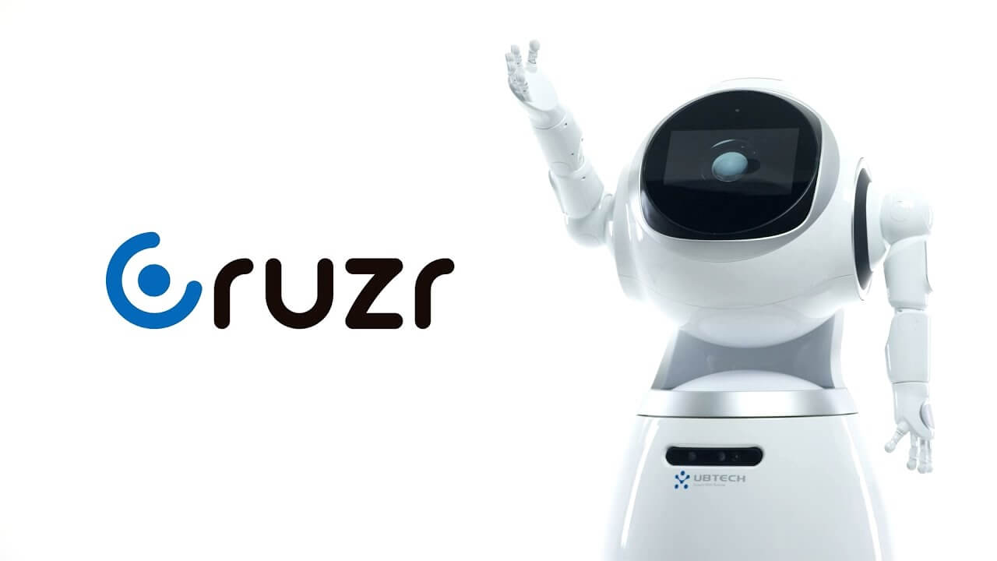

SERVICE ROBOT
Intelligent Cloud-based
Ho Chi Minh City, 2023

Slide 2





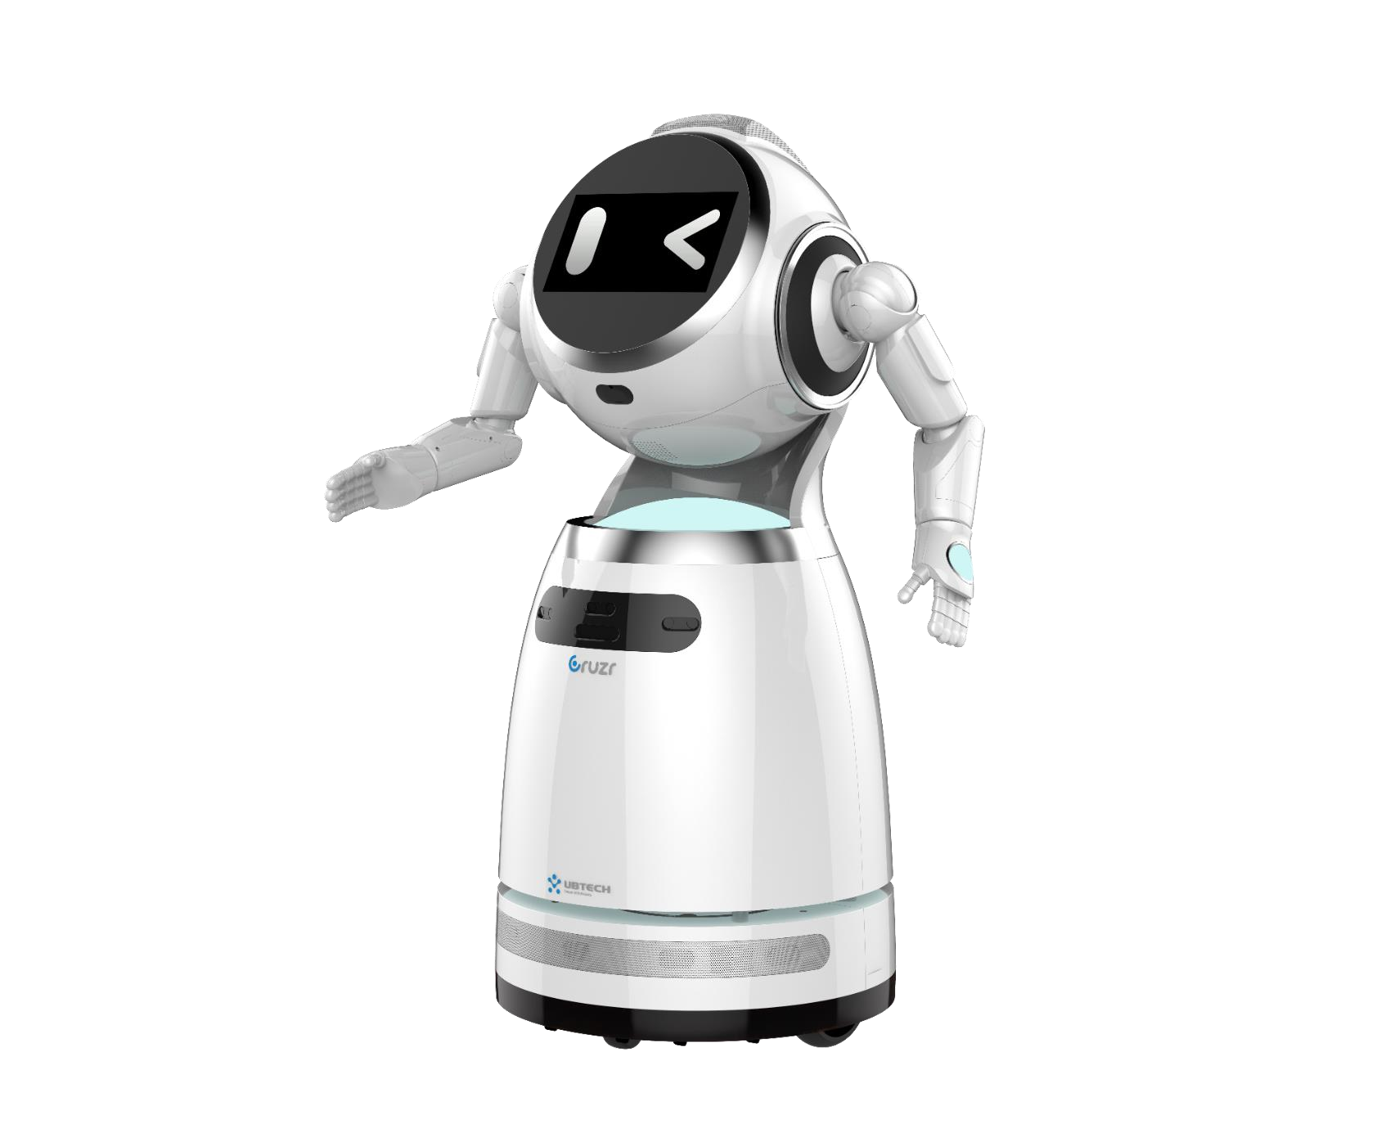
Build an AI &
Robotics Eco-System
Full Scene Application Cases
Score Technology
Mission
Vision
Why choose the Robotics Technology?
Brand Influence
Key Features

Slide 3
CONTENTS
Why choose the Robotics Technology?
Score Technology
Mission
Vision
Key Features
Full Scene Application Cases
Brand Influence

Slide 4
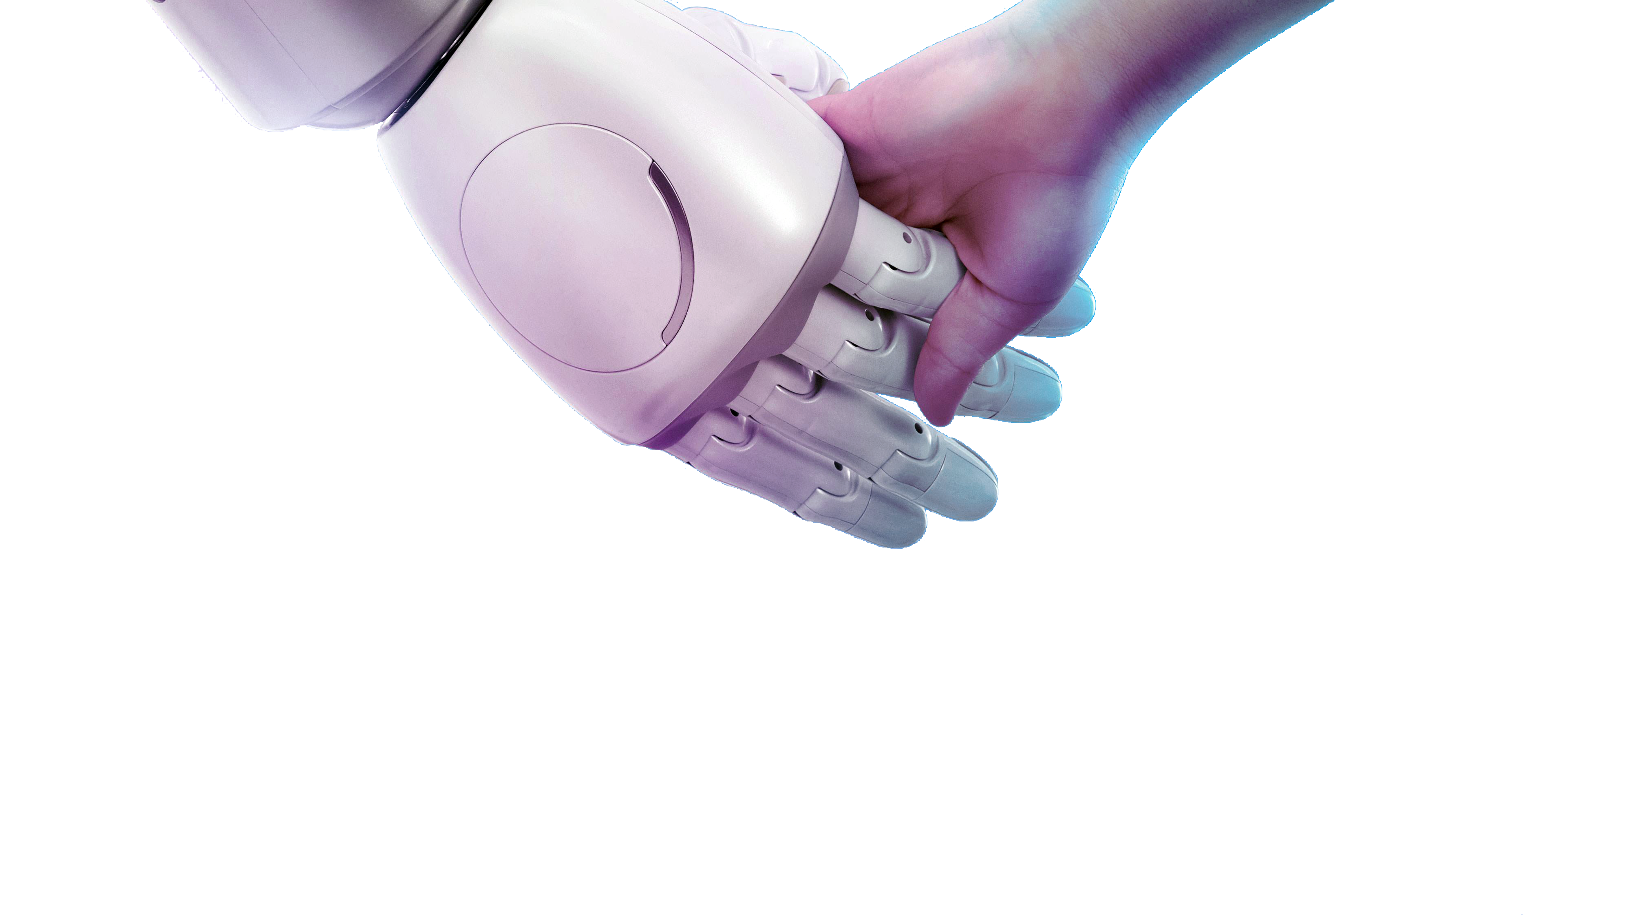
WHY CHOOSE
THE ROBOTICS TECHNOLOGY?
Dealing with repetitive tasks
Increasing working efficiency
Improving customer satisfaction
Reducing operating cost
Improving quality of service
Improving quality of service

Slide 5
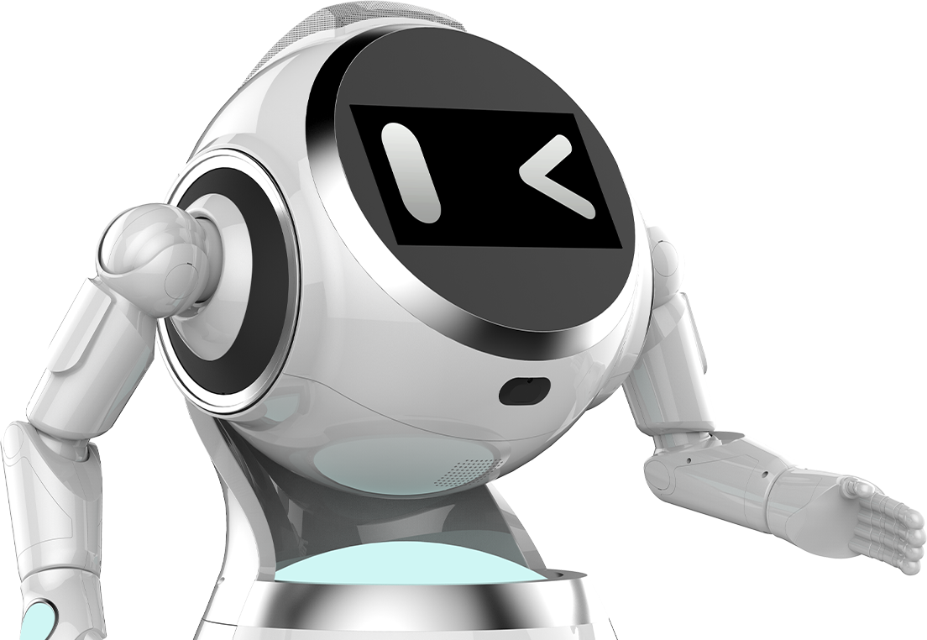
SCORE TECHNOLOGY
MISSION - VISION
Mission
Bringing intelligent robots to every family. Making everyday life more convenient and intelligent.
Vision
With our intelligent robot as a carrier and AI technology as the core, we aim to build an intelligent eco-system with hardware, software, service, and content all integrated together.

Slide 6
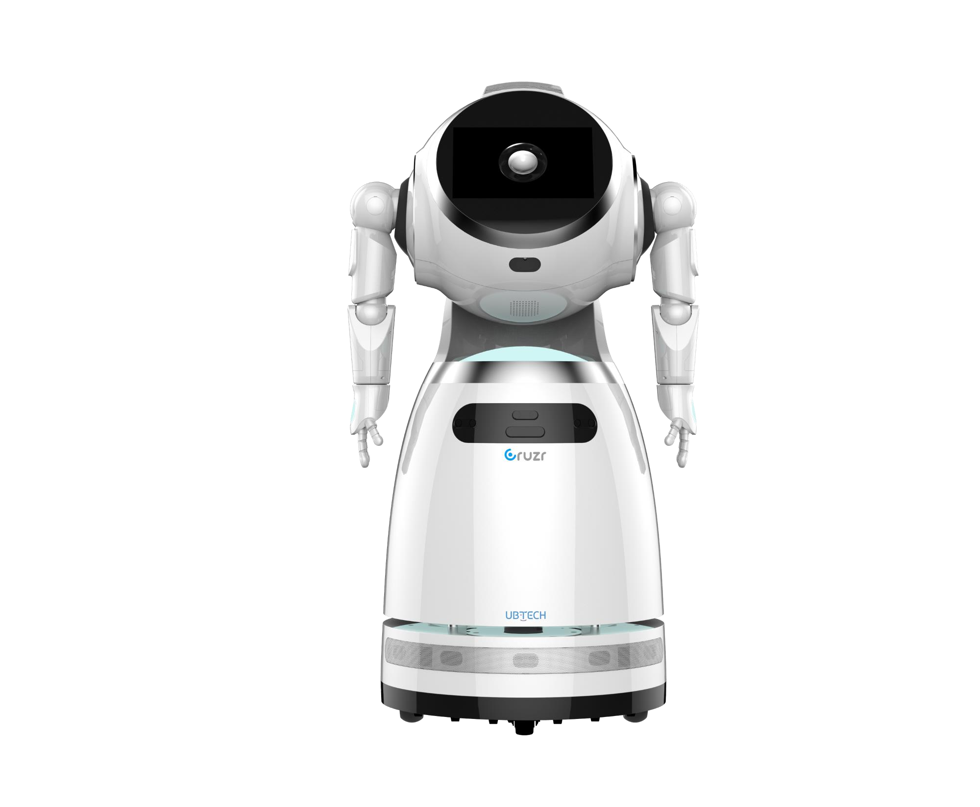


SCORE TECHNOLOGY
Systematic Technology
Systematic Technology
High-performance Servo Actuators
Robot Centered Computer Vision and perception technology
Mechanical Transmission
Intelligent speech interaction technology (ASR, NLP, TTS)
SLAM & Navigation
Human-machine Interaction
Motion planning & Controls
Eye-hand Coordination
Modular development
Potential for open source
Systematic
Technology
Integrated system
Systematic
Technology
Robot operating system application framework (ROSA)
Fushion Technology

Slide 7


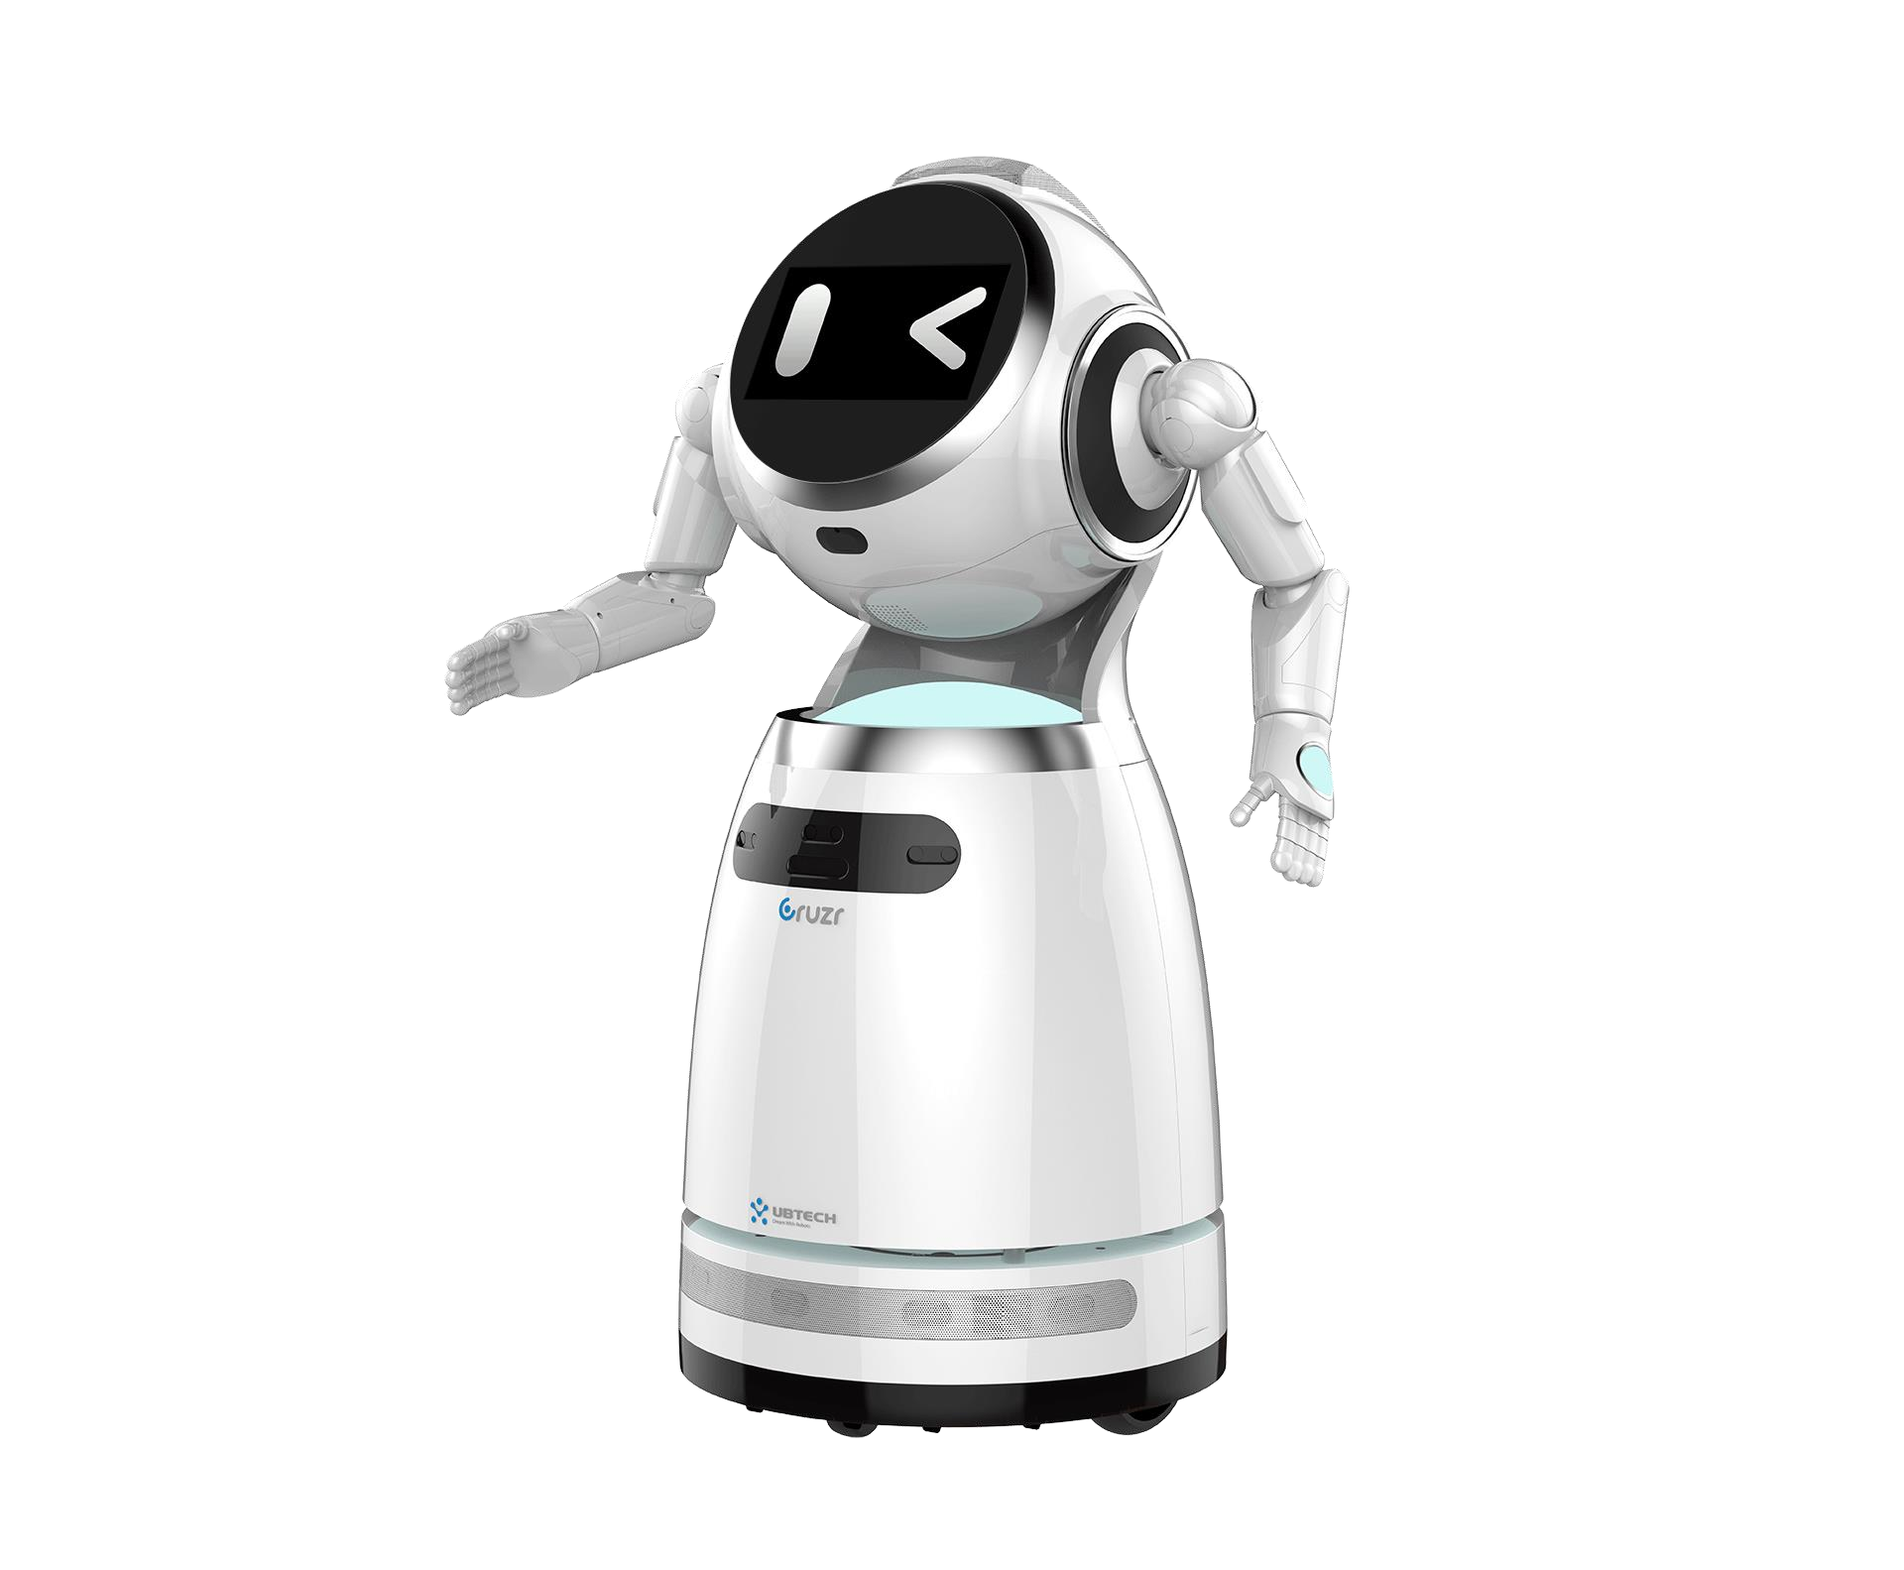









KEY FEATURES
Customized, Cloud-based, Intelligent Humanoid Service Robot
New Era for intelligent robotic service
Cloud-based Robotic OS
Customized Service
Open API
One stop solution
Friendly human-like design
Automatic recharge
Real-time stereo-Navigation
HD video conference
Accurate face recognition
Data Collection analysis
Electronic skin
Simple centralized control
Multimodal interaction

Slide 8


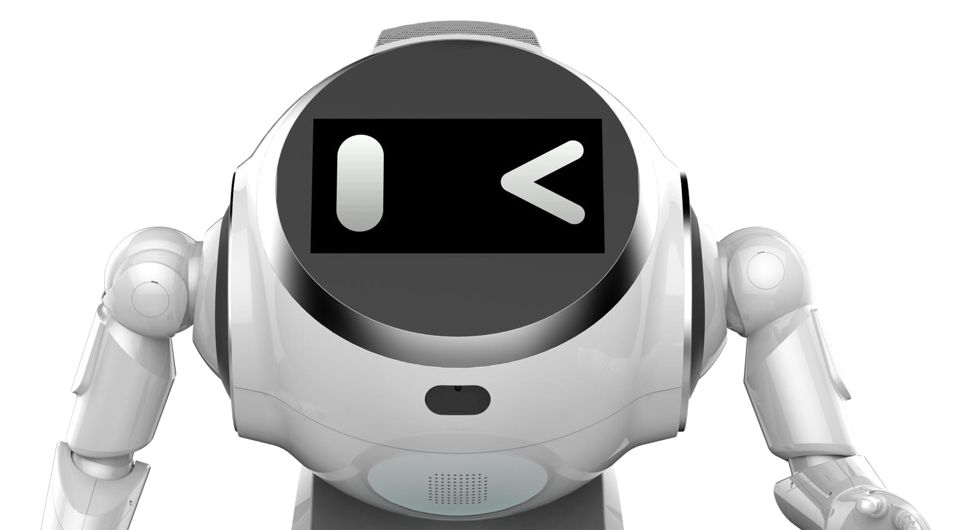
Friendly human-like design
Multimodal interaction
Humanoid Robot
“Modality” means “sense”, Multi- modal interaction is an interaction with voice, action, text, expression and other modes of communication to fully simulate human communication.
15 Degrees of Freedom (DoFs) in total
12 DoFs on shoulders and arms
360º abrasion resistant and quiet wheels
More expressive
More humanlike
More affinity
More vivid
Voice
Chacters
More friendly trustable
INTERACTION
Rich body language
Action
Vision
Smooth and stable movement

Slide 9
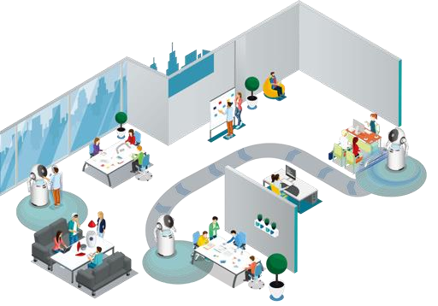

U-SLAM Navigation System
U-SLAM is short for Mobile-ID SLAM (simultaneous localization and mapping), which uses real-time positioning and mapping technology to navigate and avoid obstacles.
Real-time positioning and mapping
6 kinds of major sensors that are distributed in a 360° annular sensory array
Self-adapt to different environments
Arrive at any location with precision

Slide 10
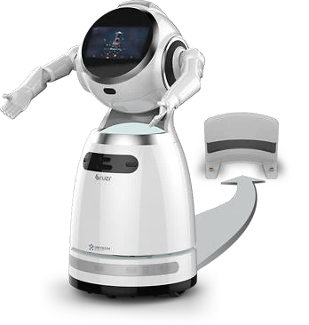
Automatic recharge
Auto return to recharging dock based on infrared sensor
8 hours working time (24 hours standby)
Covert conductive wheeling charging technology
Stable and accurate auto charging with low power consuming
Multiple charging methods: Directive recharging, Pre-set recharging, Automatic recharging

Slide 11
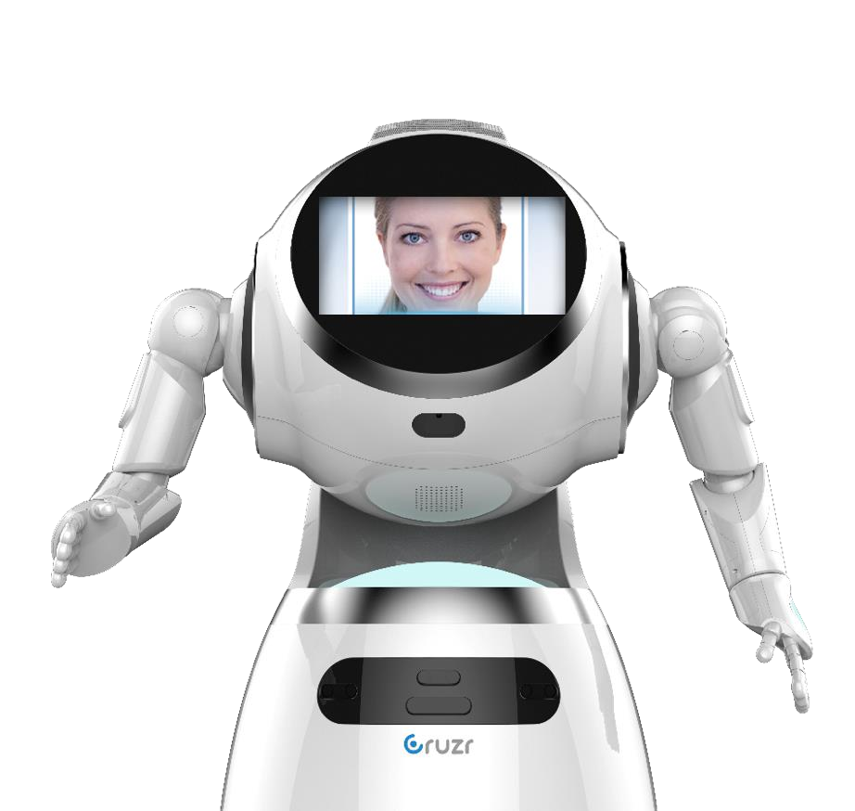


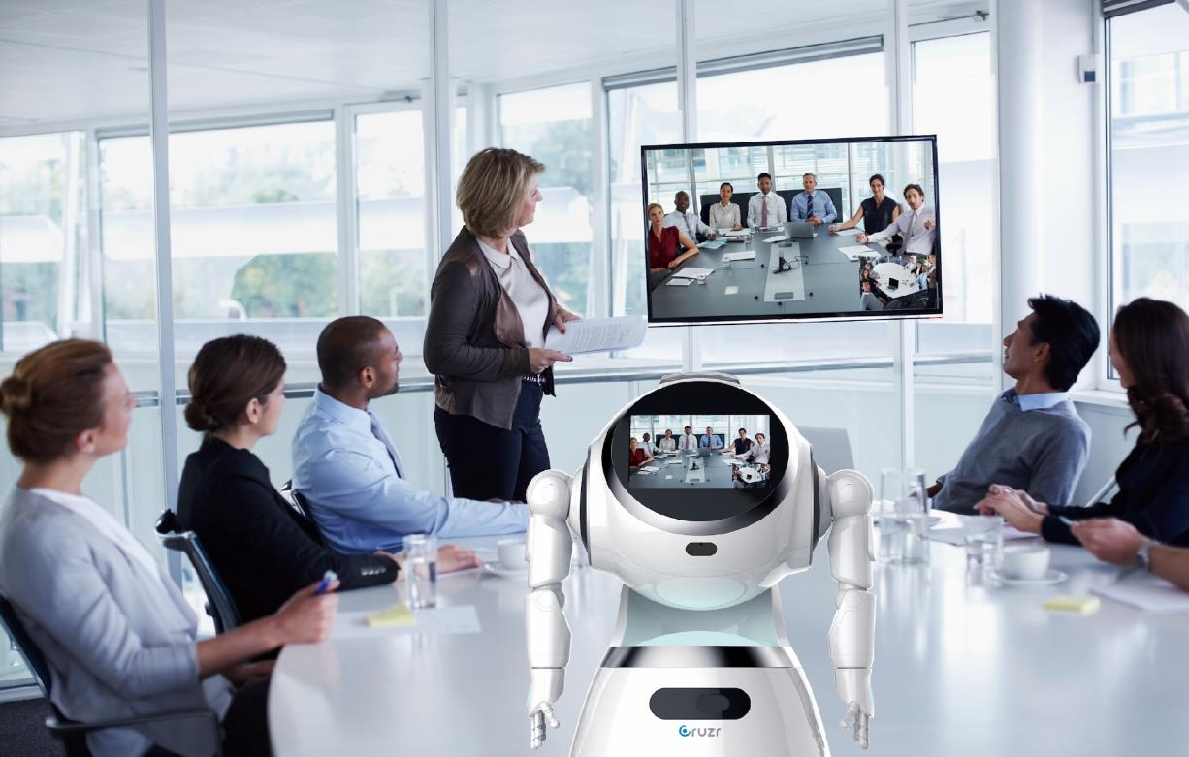

Facial recognition
U-Meeting video call system
Suitable for customer reception or profile creation
Suitable for customer reception or profile creation
U-Meeting is a business application that provides HD voice and video call functions, through high-definition audio and video codec and smooth transmission.
The recognition accuracy is up to 98%
Video-based Customer Service.
High-definition Audio and Video Codec.
Improve customer experience via knowing by a robot
Secured Video Data Transmission.
Faster Face Recognition
Clearer
More accurate Face Recognition
Faster
Safer

Slide 12
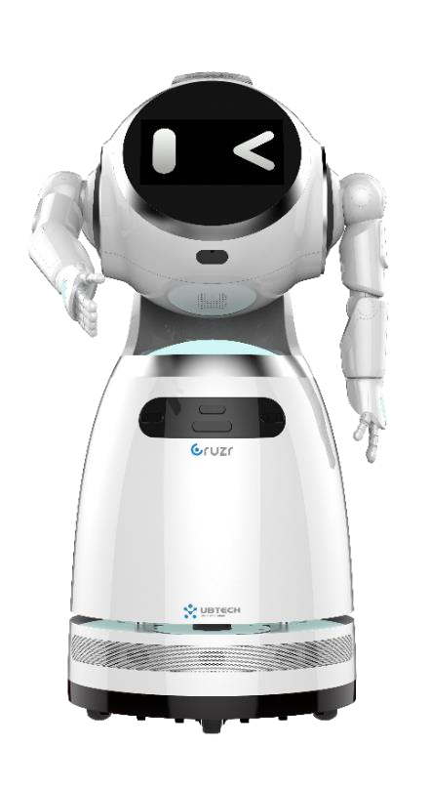
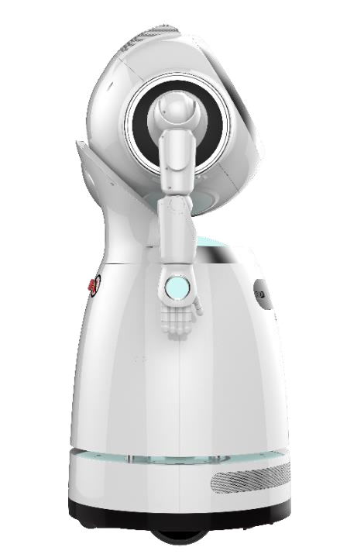


Enhanced Safe-Assurance with E-skin
Auto power off protection on arms
High Sensitivity
Fast Response
Soft
High Sensitivity
Dual Protection
Large Detecting Area
Fast Response
When any obstacles detected, the arms will stop moving which could avoiding unexpecting harm to people around and self-damaging.

Slide 13
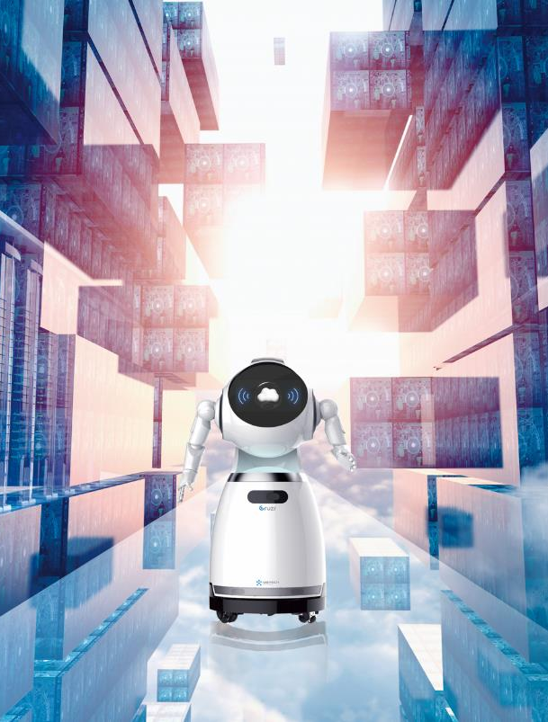

Big Data Analysis and Management
Discover effective information to obtain better business value
Data acquisition, storage and analysis
High-efficient data acquisition
Secured data storage
Intelligent data analysis

Slide 14
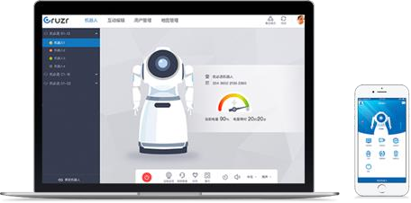
Centralized control System
Centralized Control System
Multiple Robots Patrolling Control
Multiple Robots Remote Advertising
Convenient Multi-robots Control
Advanced Intelligent Way Patrolling
Convenient Advertisement Pushing

Slide 15
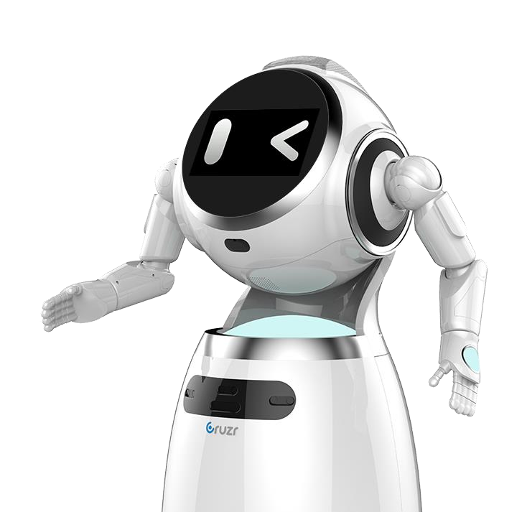


Customizable Service with open APIs
SDK Package
Open APIs for third party application development
Open APIs for third party application development
Customizable application
Expandable solution

Slide 16
6+0 MicArray
(covering 3-5 meters)
13MP HD Camera
11.6 inch high resolution Touch Screen
TOF Sensor
Product Parameters
3 inch speaker (head)
RGDB Sensor (camerawith
Depth perception, Sonar Sensor)
Status LED
Sona sensor
Lidar and Status LED
3 inch speaker
(bottom)
Sona and IR sensor
2*Driver Wheel，2*Slave Omni-directional Wheel

Slide 17
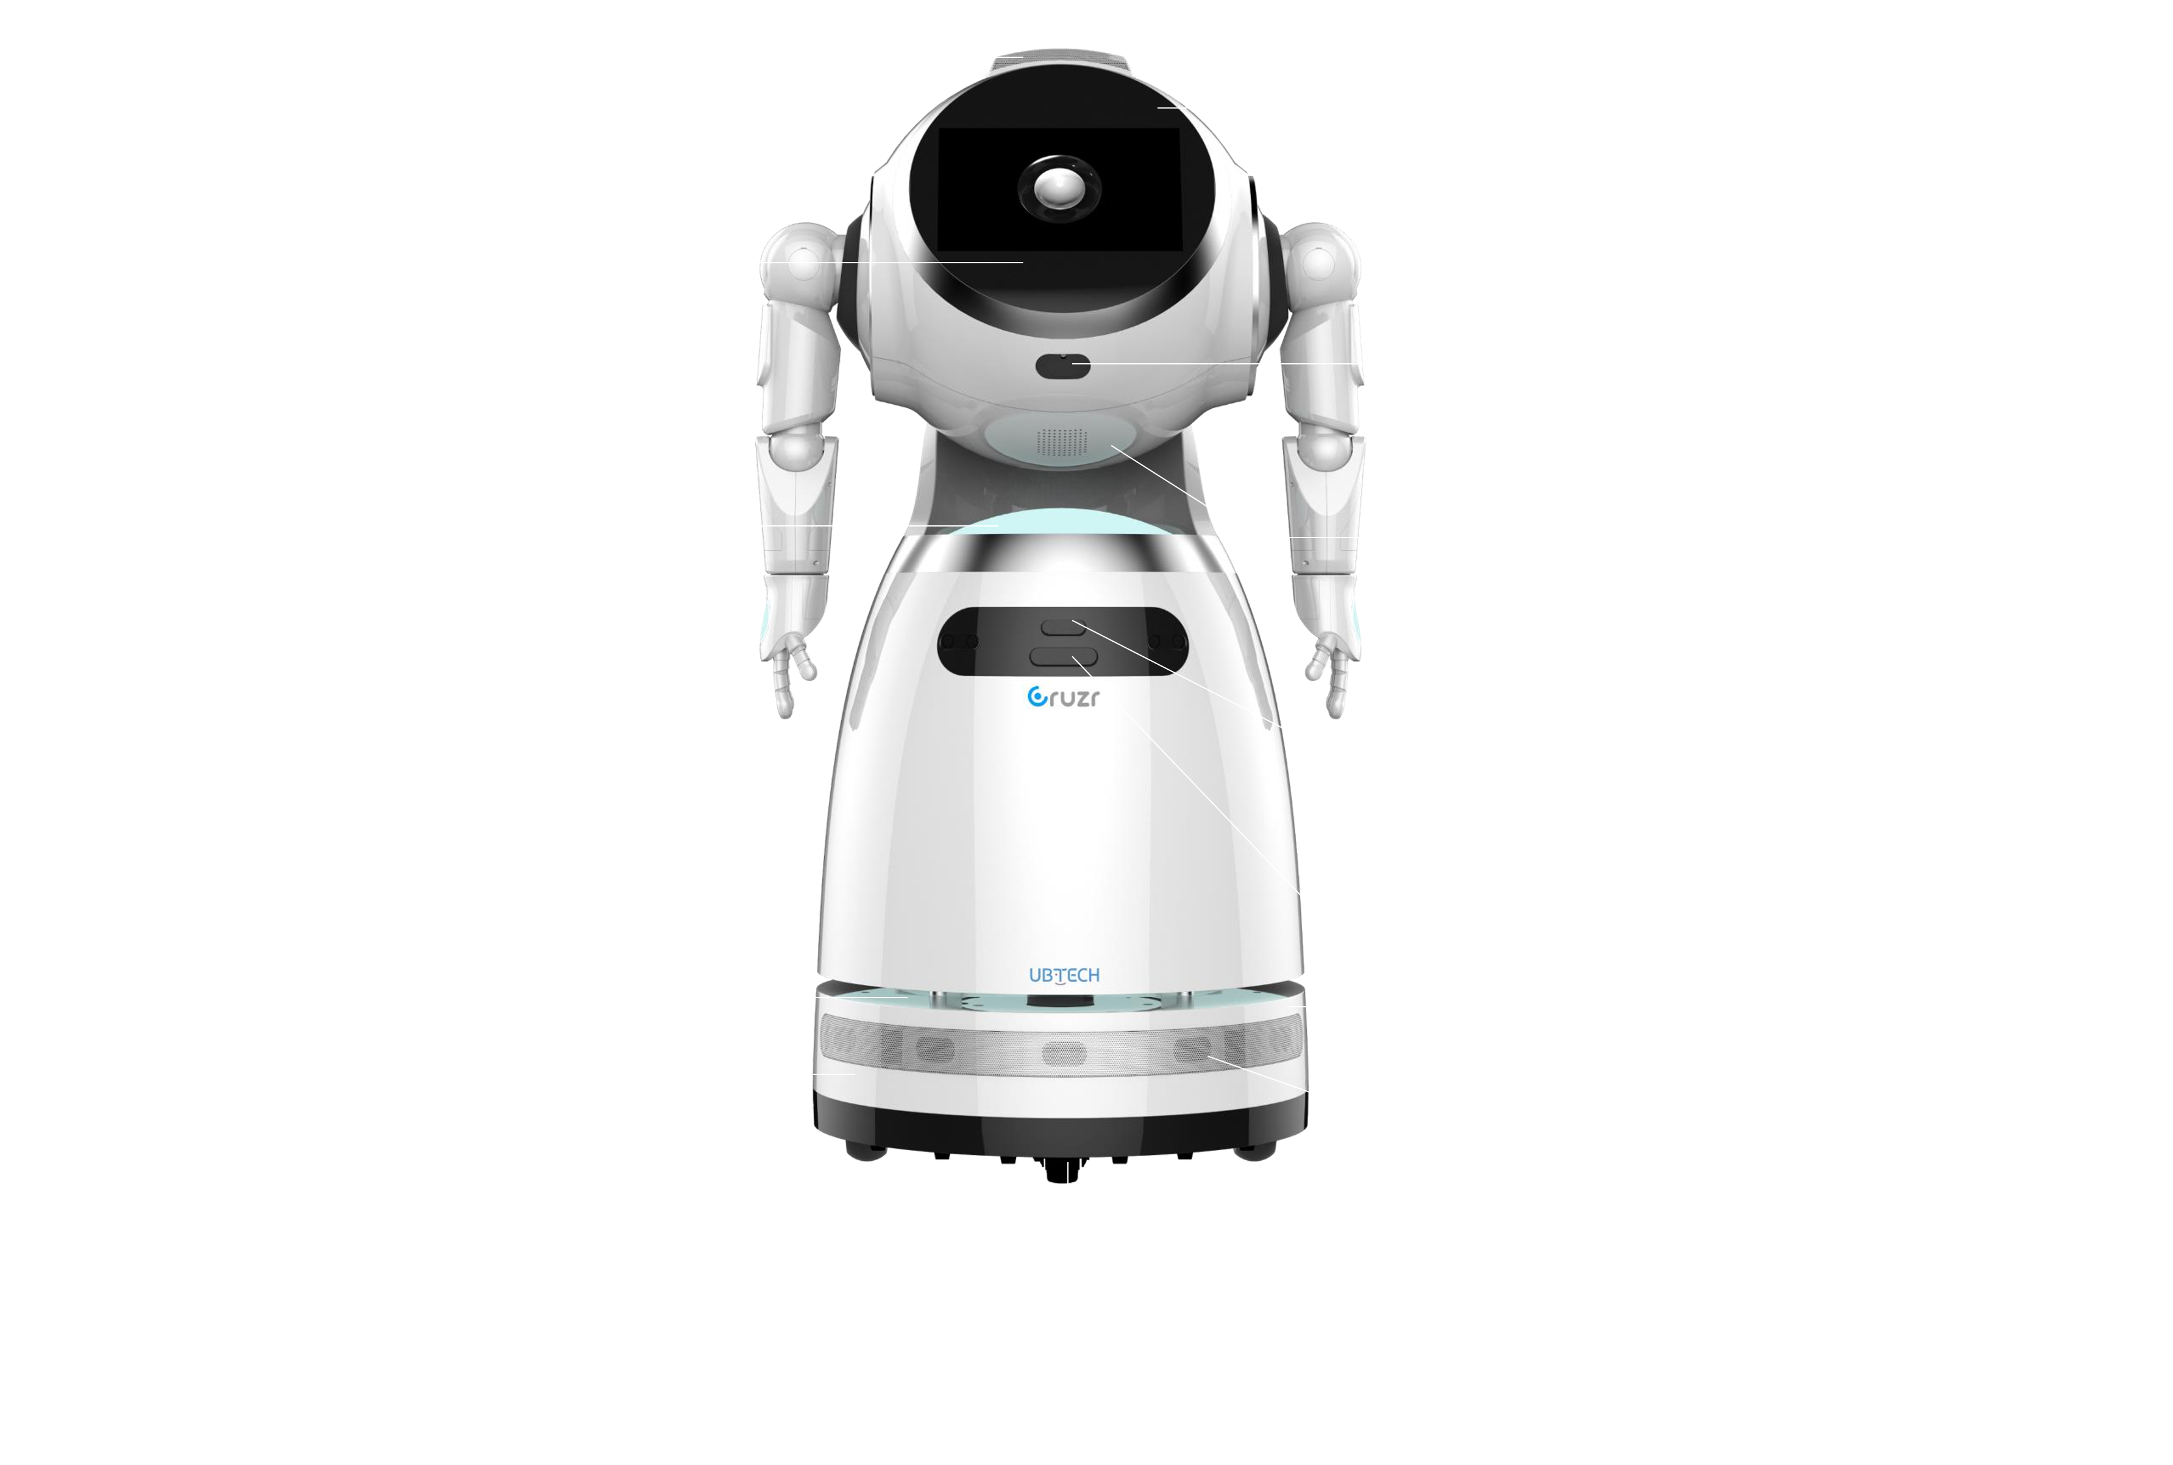
Product Parameters
Dimension: 1214(H)*630(/V)*537(D) (mm)
Screen: 11.6inch TFT HD Touch Screen
Maximum height obstacle to pass: 2cm
Maximum climbing angle: 6º
Speed: 0.3/0.5/0.7M/S (Max is 1M/S)
Laser radar: 360º
Weight: 45kg
Resolution: 1920*1080
Maximum width of gap to pass: 3cm
Communication: wifi (2,4G/5G), 4G Module
E-skin: 3*2 (two Arms, 3pic/one Arm)
Navigation sensor: RGDB Sensor*1, close sona sensor*3, Open sona sensor*5, IR sensor*6, Lidar sensor*1, Recharger Infrared*2, TOF sensor*1
Speaker: 85dB

Slide 18


Application Scenarios
Garage
Medical Treatment
Traffic
Party building
Retail
Government Affairs
Exhibition
Finance
Education
Hotel

Slide 19
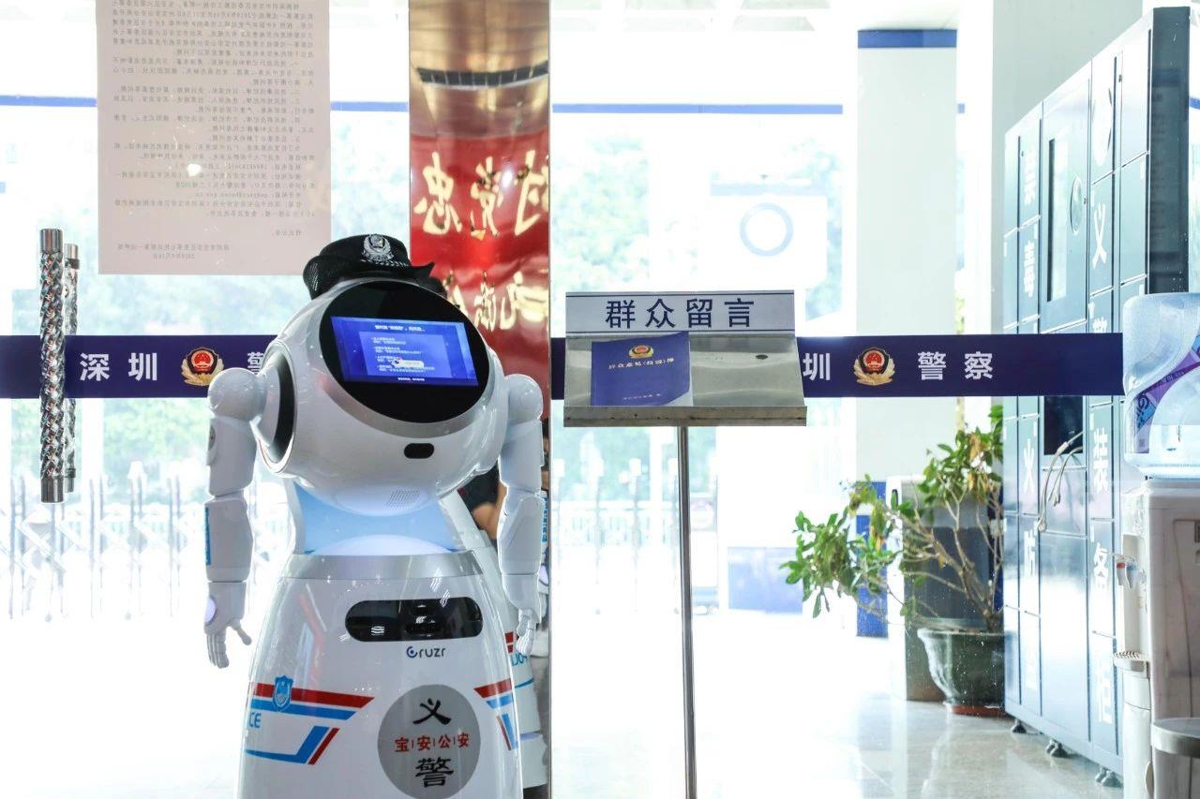
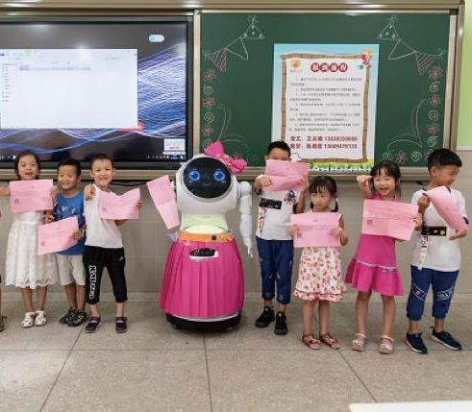
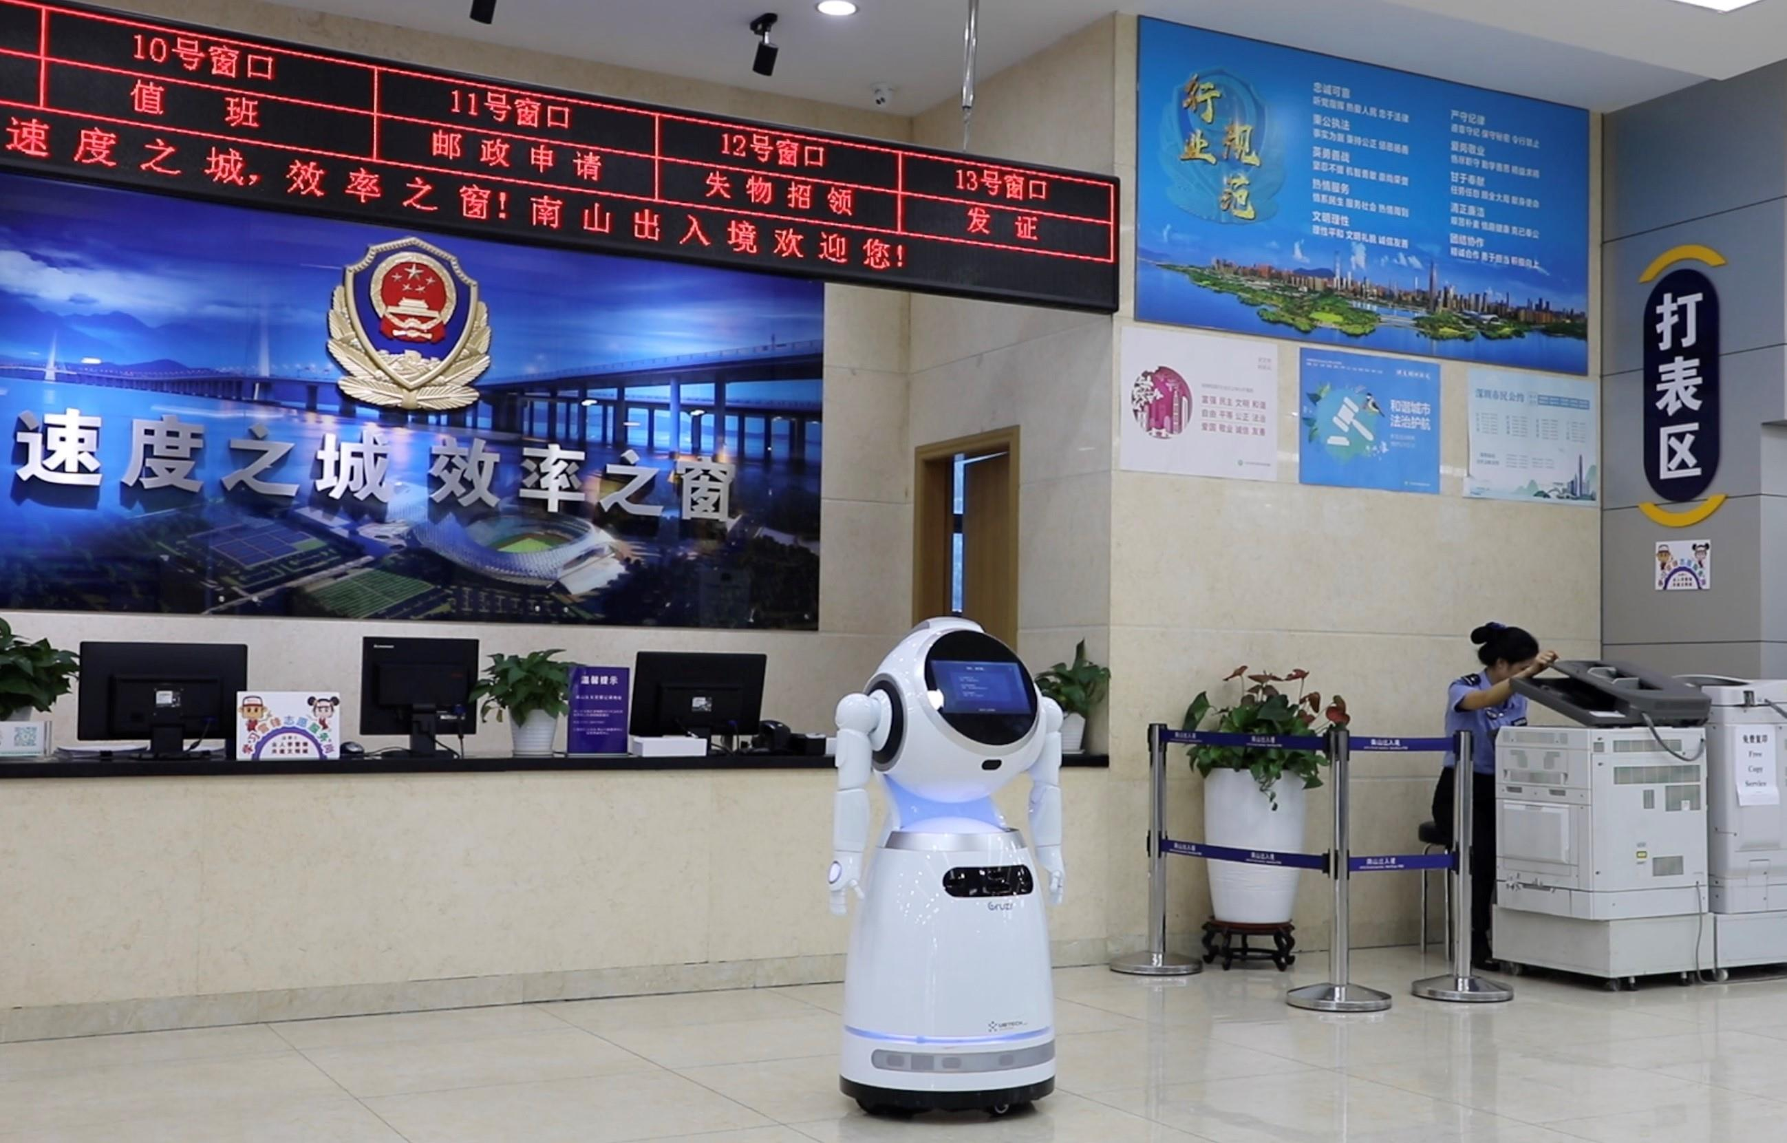
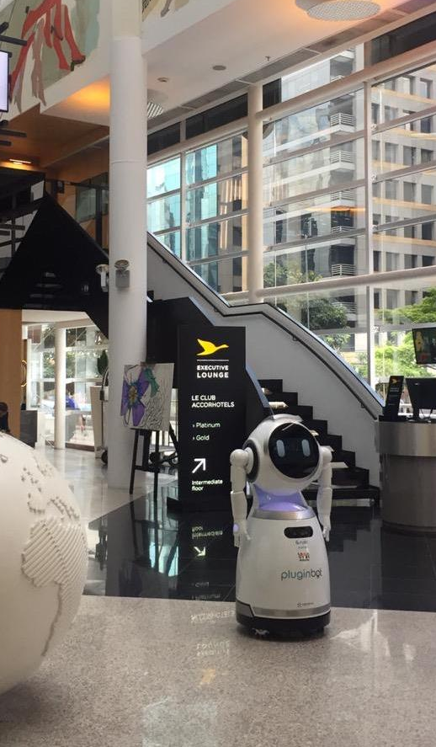
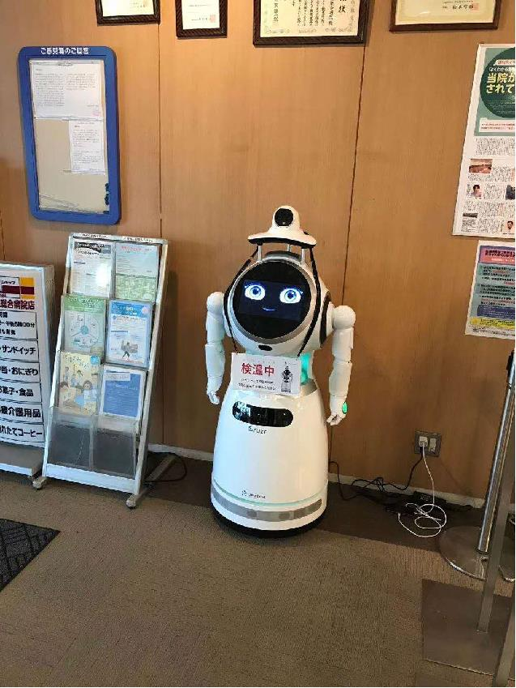
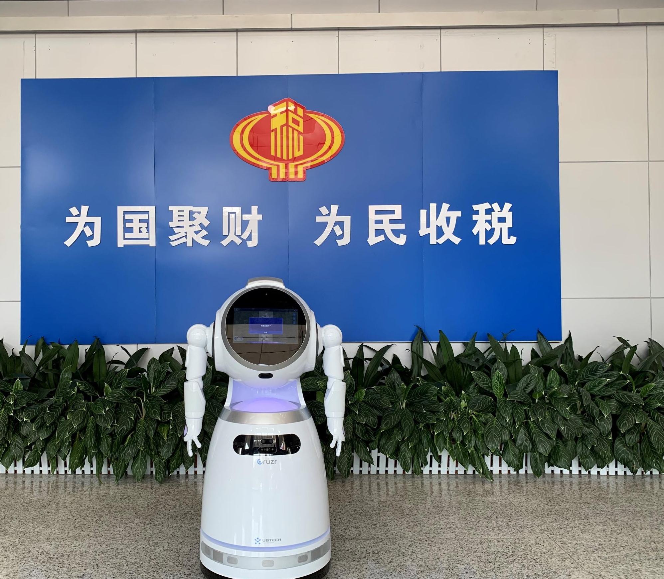
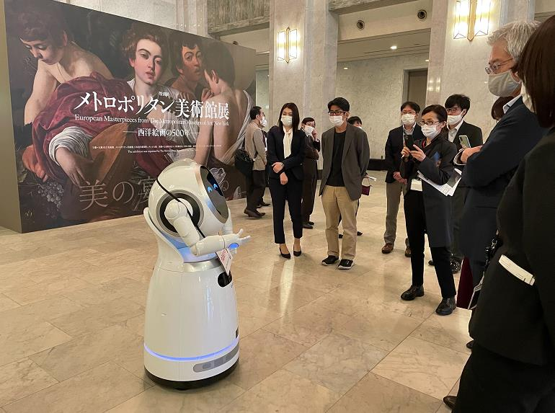
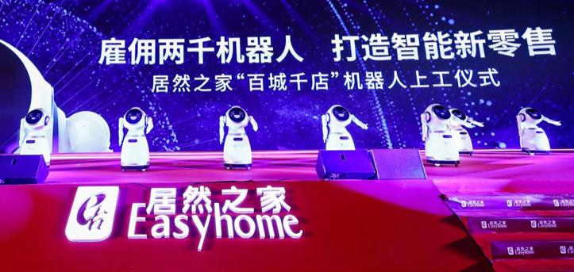
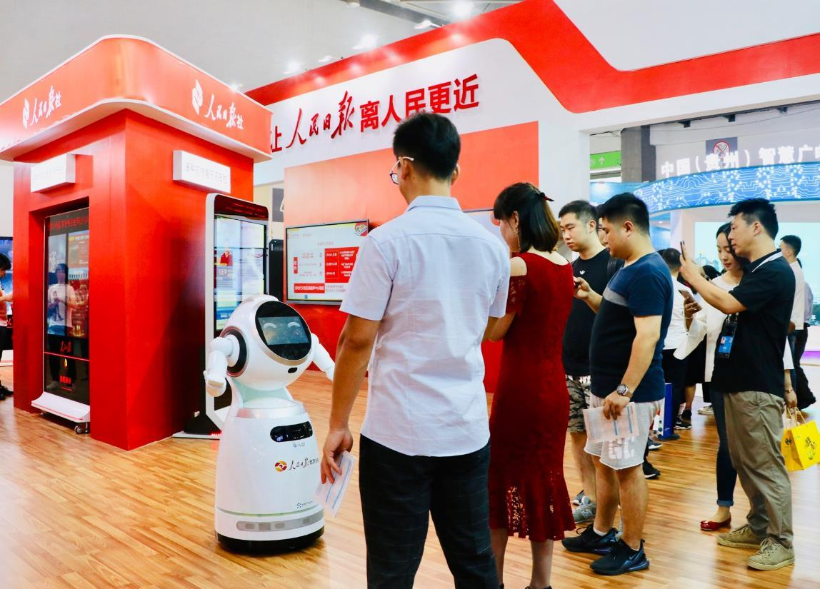
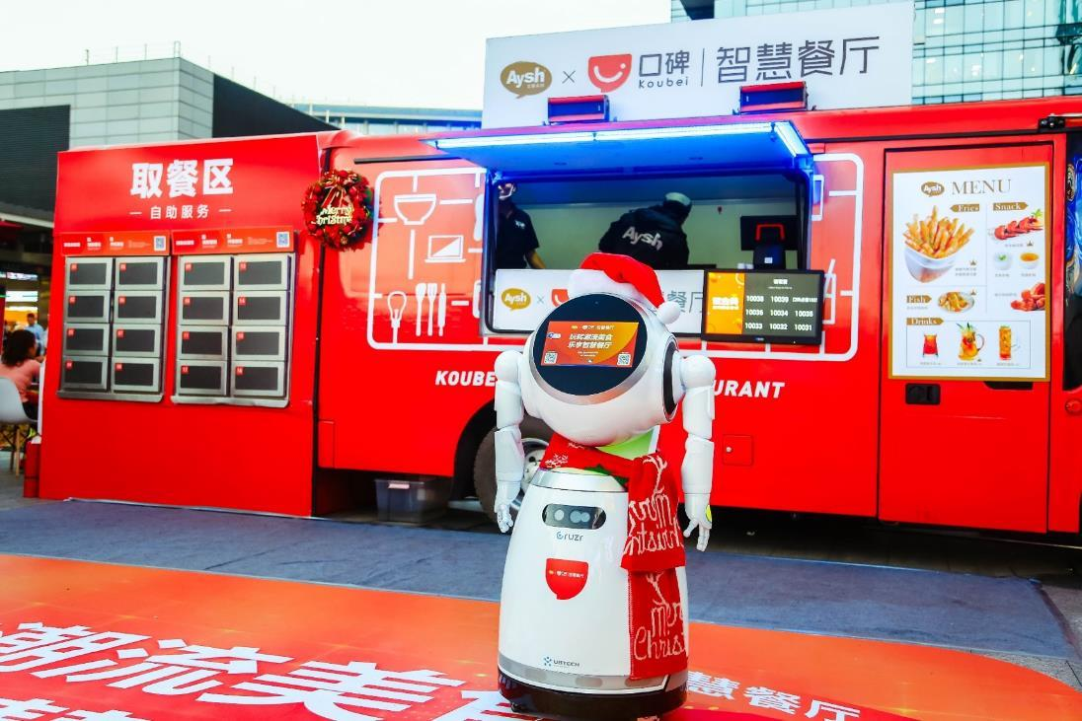

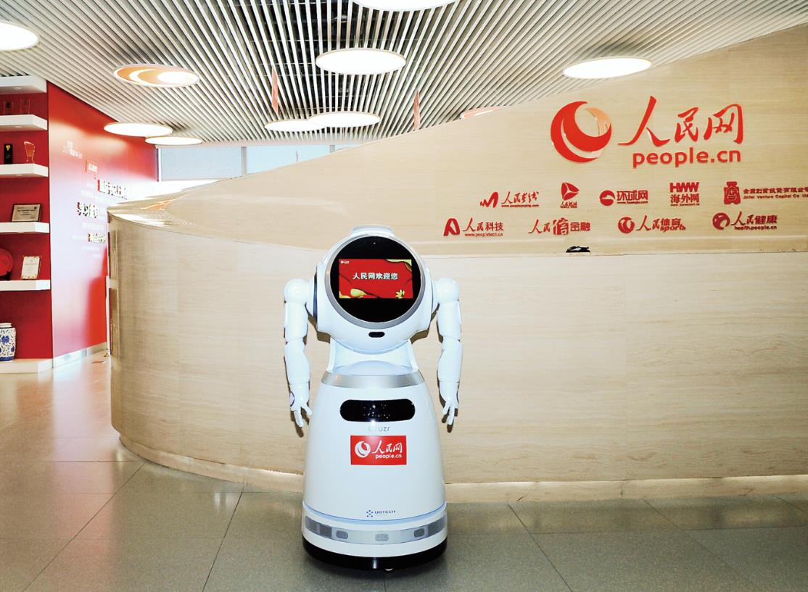
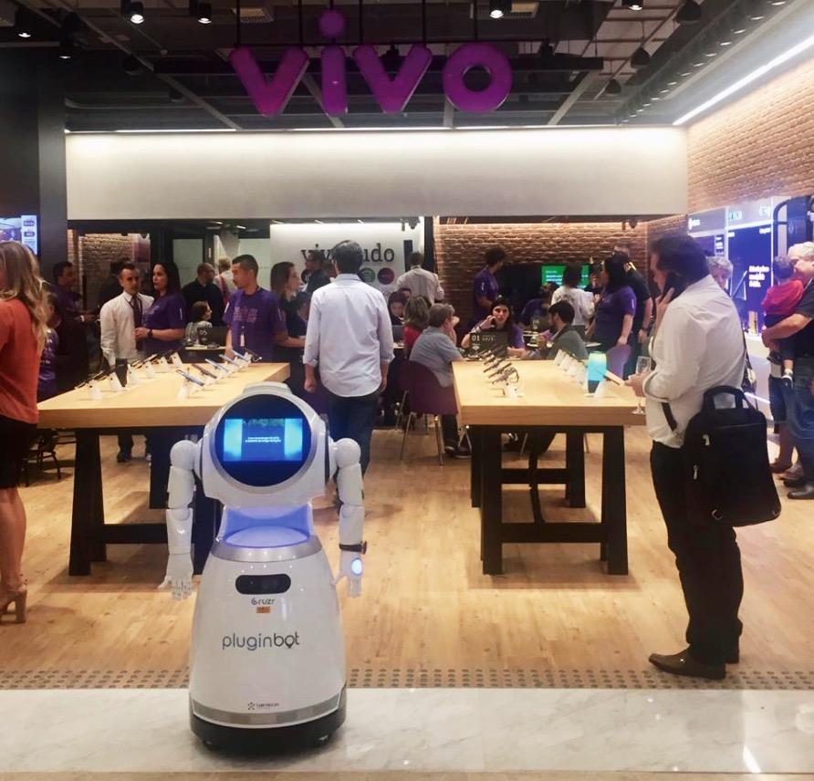
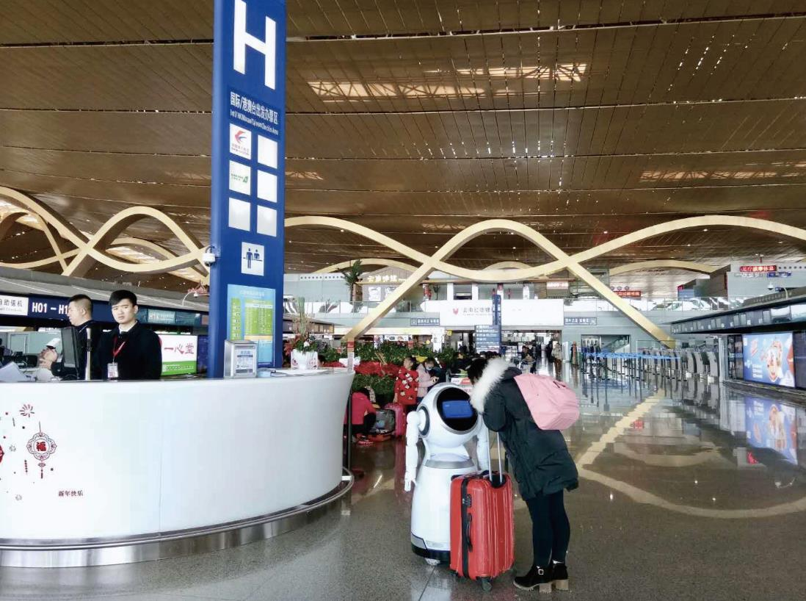
Full scene
Application Cases

Slide 20





AI+ Retail Application Cases
Entertainment functions like signing and dancing can effectively attract customers.
“Easyhome class” function:
Enhance customers understanding of the industry and trigger relate consumption;
“Easyhome Challenge” game function:
Increase customer retention time.
Share responsibility of part of the inquiry work to relieve the lack of manpower during peak period of business.
Nearly 1,000 Cruzr robots will be stationed in Jaymart, it is of great significance for transformation of the traditional retail mode
Utilizing the innovative technologies of AI robots to further accelerate the process of smart cities, thereby helping the development of “Thai Industry 4.0”.
Mobile-ID and Jaymart jointly signed the Cruzr entry contract. Thai Minister of Industry Udama attended and witnessed the signing ceremony.

Slide 21

AI+ Restaurant Application Cases
When Cruzr sees customers, the active welcome function brings them a homecoming experience
Cruzr takes customers to the reserved table and recommends related dishes
Customers can order dishes and pay through Cruzr, and score the dishes and restaurants
Customer can know the background of brand and dishes through Crurz. After dinner, Cruzr can also issue coupons to attract customers to come back next time

Slide 22
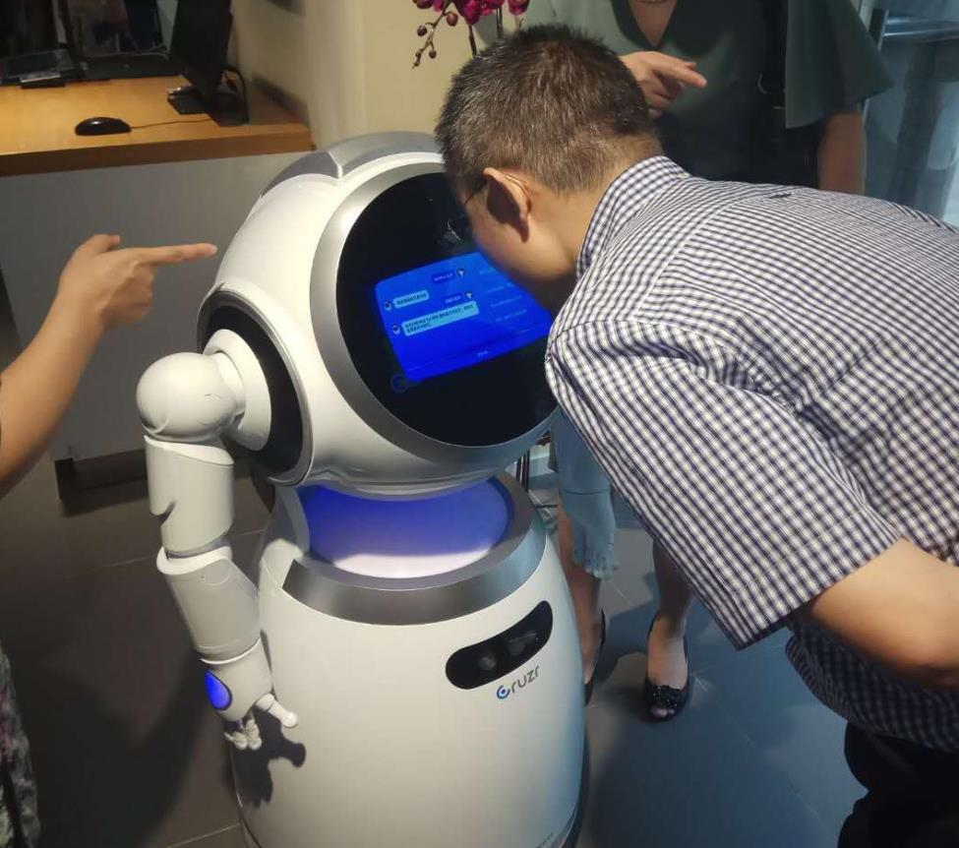

AI+ Service Hall Application Cases
Customer could interact with Cruzr through voice, vision, text, and quickly find commodity information and location through Cruzr
Actively provide product promotional information, enhance customers experience, and increase the purchase rate
Provide membership registration service and answer customer inquiries
Collection and analysis of operational data, extracting value information from massive data and establishing exclusive database

Slide 23
AI+ Service Hall Application Cases
As the first robotic salesman in the flagship service hall, it provides help and guidance to customers, as well as inquiry and reception services
In Telstra Intelligent Café, Cruzr servers as a robotic waiter, selling coffee to customers, improving sales volume and attracting attention
Providing inquiry service and simple business processing, etc.

Slide 24
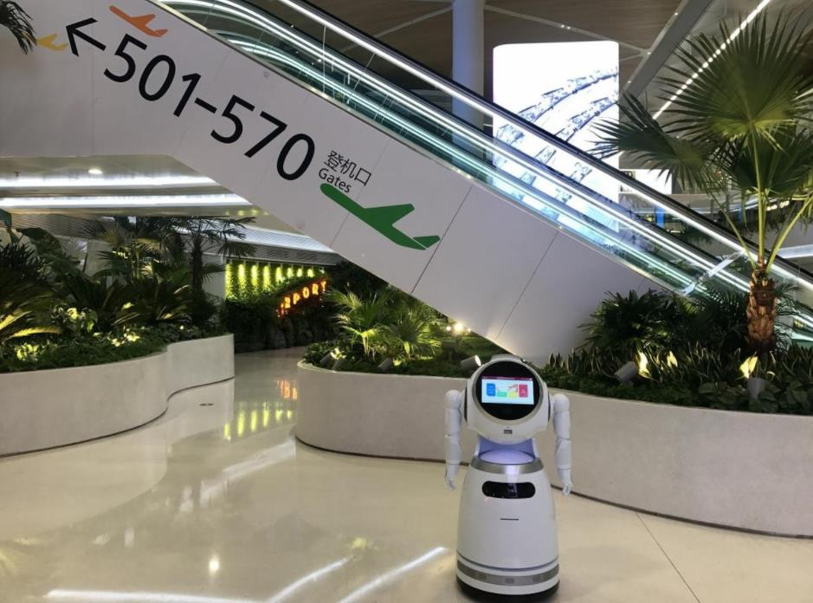
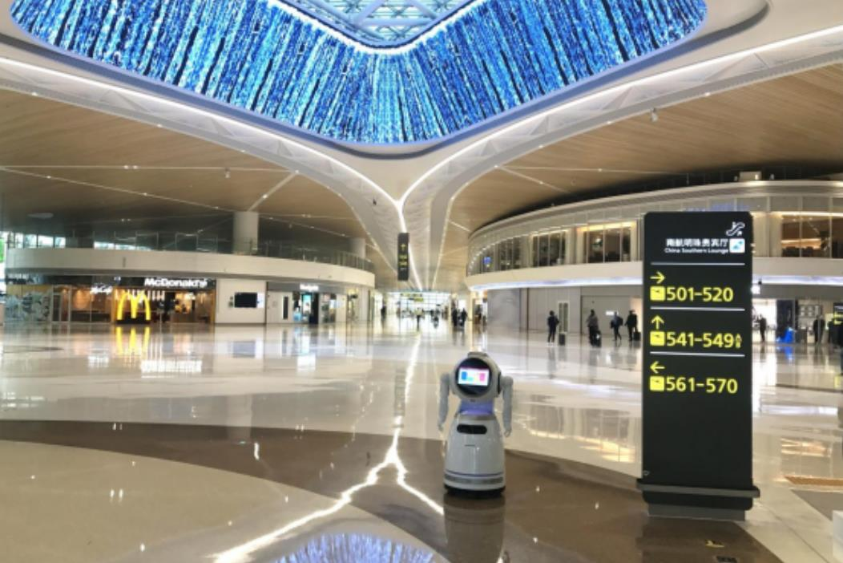
AI+ Airport Application Cases
A breakthrough of robotic application in Positioning and Navigation in extra-large scale landscape.
UBTECH-SLAM technology empowers Cruzr to move freely in an extra-large scale landscape of over 200,000 m²
Passengers can use Cruzr for terminal guidance, flight information inquiry, destination inquiry, business process inquiry, airport services, passenger instruction, etc.

Slide 25
AI+ Airport Application Cases
Cloud intelligent Q&A System with deep customization, Richness and Learning extension
If you encounter a question-and-answer blind area or have urgent affairs to deal with, you can contact the video customer service center by Cruzr
The only one in China to realize autonomous localization and navigation of robots in large scenes
Cloud service base flight information integration, which is accurate, efficient and real-time, guide customers to self- check-in machine

Slide 26
AI+ Government affairs
Application Cases
When visitor arrived, Cruzr could automatically great guests, to say customized greeting words, also to play pictures, video and promotional information at the same time.
Interactive modes of voice and touch screen, enable Cruzr to share part of the inquiry work and relieve the lack of manpower situation
Cruzr provides guided tours function to guide visitors along established routes or to designated locations

Slide 27

AI+ Party Building Application Cases
Read and listen to the “People’s Daily” through Cruzr, and view the party building work on a certain day through the “Party building calendar” function
Through Cruzr, we can learn the video course of Party building, consult “Study hard” speeches and articles, consult ideological policies and party history materials
Hundreds of party Constitution questions and answers on Cruzr cloud, party member can consult party affairs knowledge through Cruzr
Cruzr has built-in interactive function such as “the strongest brain in Party building” and “talking pictures with me”, and built-in red song and dance to enhance interaction with party members of the masses

Slide 28
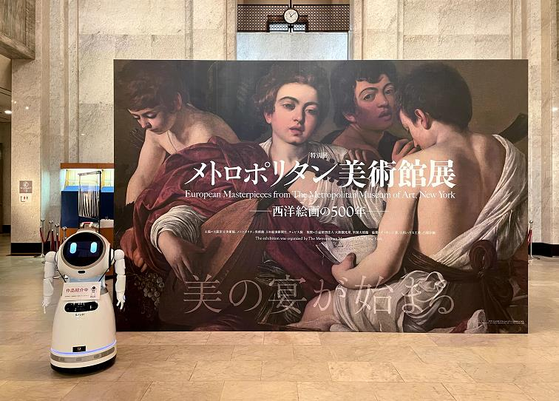
AI+ Exhibition Application Cases
The Robot Museum Guide: A Perfect Combination of AI & Fine Arts
Cruzr can precisely guide visitors to any exhibits through the U-SLAM stereo navigation obstacle avoidance system
The 13 million HD camera can monitor the venues in real-time, report the matters needing attention in mobile broadcasting, and helps administrators stay on top of the current state of each area in real-time

Slide 29
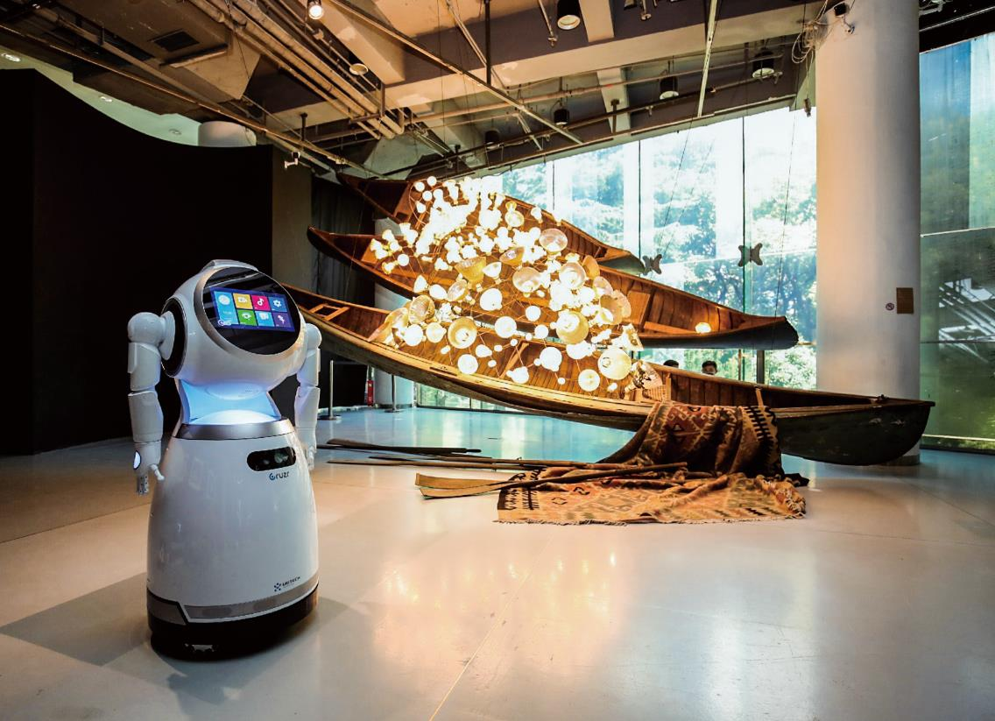
AI+ Exhibition Application Cases
Crurz Robot can precisely guide visitor to any exhibit through the U-SLAM stereo navigation obstacle avoidance system
Storing thousands of exhibit information and historical stories in the brain, together with massive and real-time updated cloud platform knowledge base, can answer the related questions about exhibits
The 13 million HD camera can monitor the venues in real-time, report the matters needing attention in mobile broadcasting, and helps managers understand the situation of each area in the exhibit hall in real time

Slide 30
AI+ Education Application Cases
Welcome teachers, students and visitors in exhibition halls, characteristic classroom and activity rooms
Acting as a lecturer in characteristic rooms and activity rooms, introducing the application situation to visitors
Promote the characteristic classroom knowledge, expand extracurricular knowledge and assist teachers in classroom interaction
Information introduction with video and pictures, more convenient for visitors to understand, and easier to get attention

Slide 31


AI+ Hotel Application Cases
Cruzr enters the high-end hotel smart service, provides information consultation, check-in and check-out services for guests
Provide customers with other intimate services, such as introduction of surrounding attractions, food recommendation, traffic status inquiries, etc.
At the front desk of the hotel, Cruzr is using technology to manage big data, reduce hotel operating costs and improve management efficiency

Slide 32

AI+ Tax Application Cases
Cruzr robot can introduce the functions area and settings of Nashan Tax service Administration for citizens and enterprises to any exhibit through the U-SLAM stereo Navigation obstacle avoidance system
Provide tax consultation and show distinctly different tax processes for citizens and enterprises
Patrol broadcasting new tax regulations, publicity video, national tax policy, etc., which become the brightest window of the Administration

Slide 33
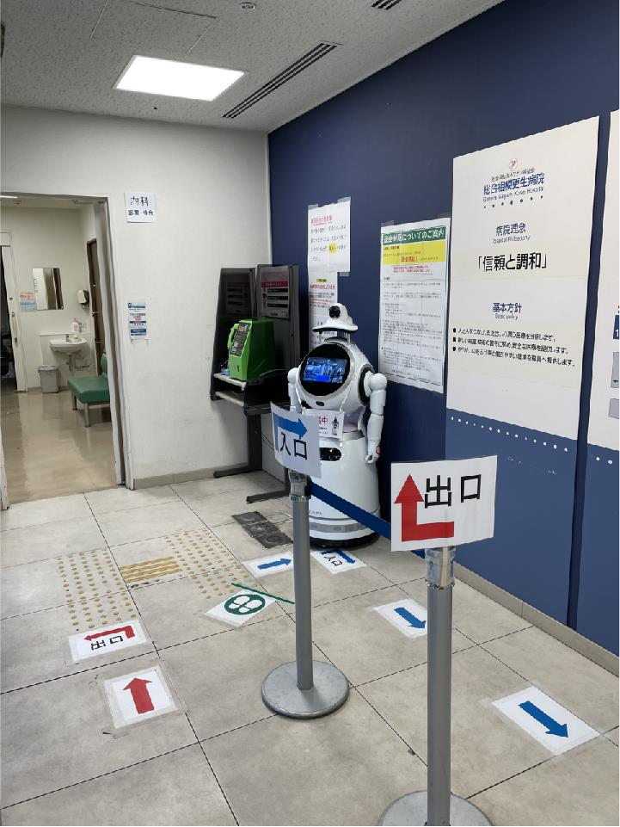
AI+ Medical
Application Cases
Cruzr conducts thermometry, mask detection and mask reminder at the entrance
Cruzr provides hospital section category introduction to patients
Cruzr demonstrates clearly positions and routes of different sections and facilities of hospital through the U-SLAM stereo Navigation obstacle avoidance system
Hospital applications in Japan
Asao general Hospital
General Samagi Kosei Hospital

Slide 34
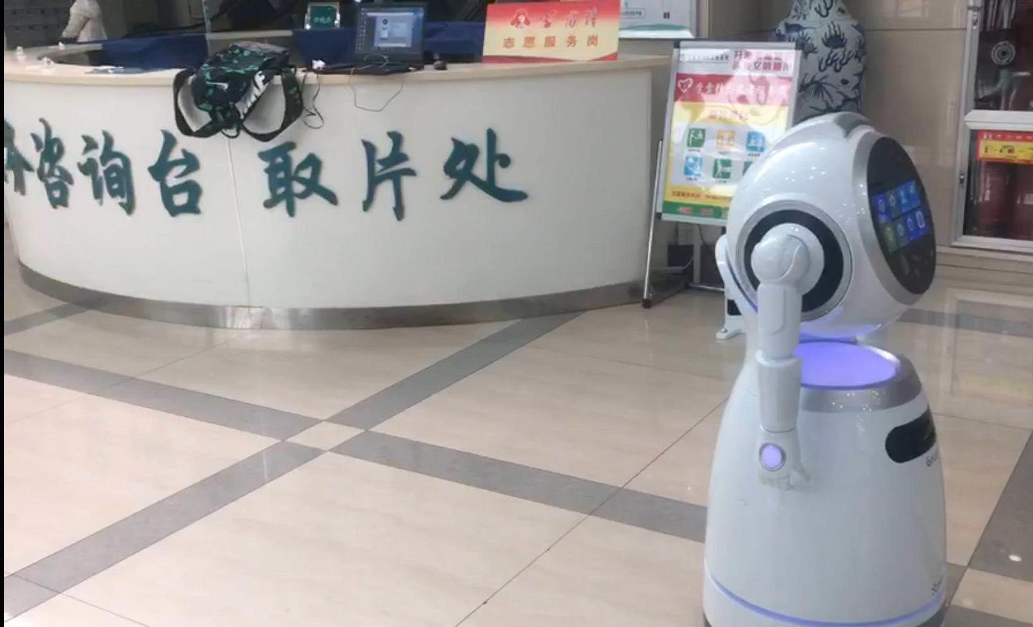

AI+ Medical
Application Cases
Cruzr provide hospital information, healthy nutritional knowledge and medical insurance policy advisory
Provide illness primary diagnosis, give treatment sections suggestion, assist self registration, medical insurance payment
Provided hospital section category introduction, including section and doctor’s brief introduction
Demonstrate clearly positions and routes of various sections and facilities of hospital through the U-SLAM stereo Navigation obstacle avoidance system

Slide 35

AI+ Public Security
Application Cases
Cruzr integrates vigilante commanding and dispatching system, communicates with 10,000+ vigilantes instantaneously, and makes a real-time report of vigilantes’ team circumstance to leaders
In the disaster and public emergency, Cruzr can participate in the mass prevision to do mass response. During 2020 epidemic, be a positive member, which show us science techniques assist epidemic prevention work in the public security
Provided the masses legal advice, professional knowledge Q&A related police service, and other kinds of advices in the police station, relieves the polices stress, optimizes the police deployment in the basic sorts.
Assembles services information on various domains including point system, Entry-exit, drug control, legislation etc., and make a powerful legal knowledge base.

Slide 36
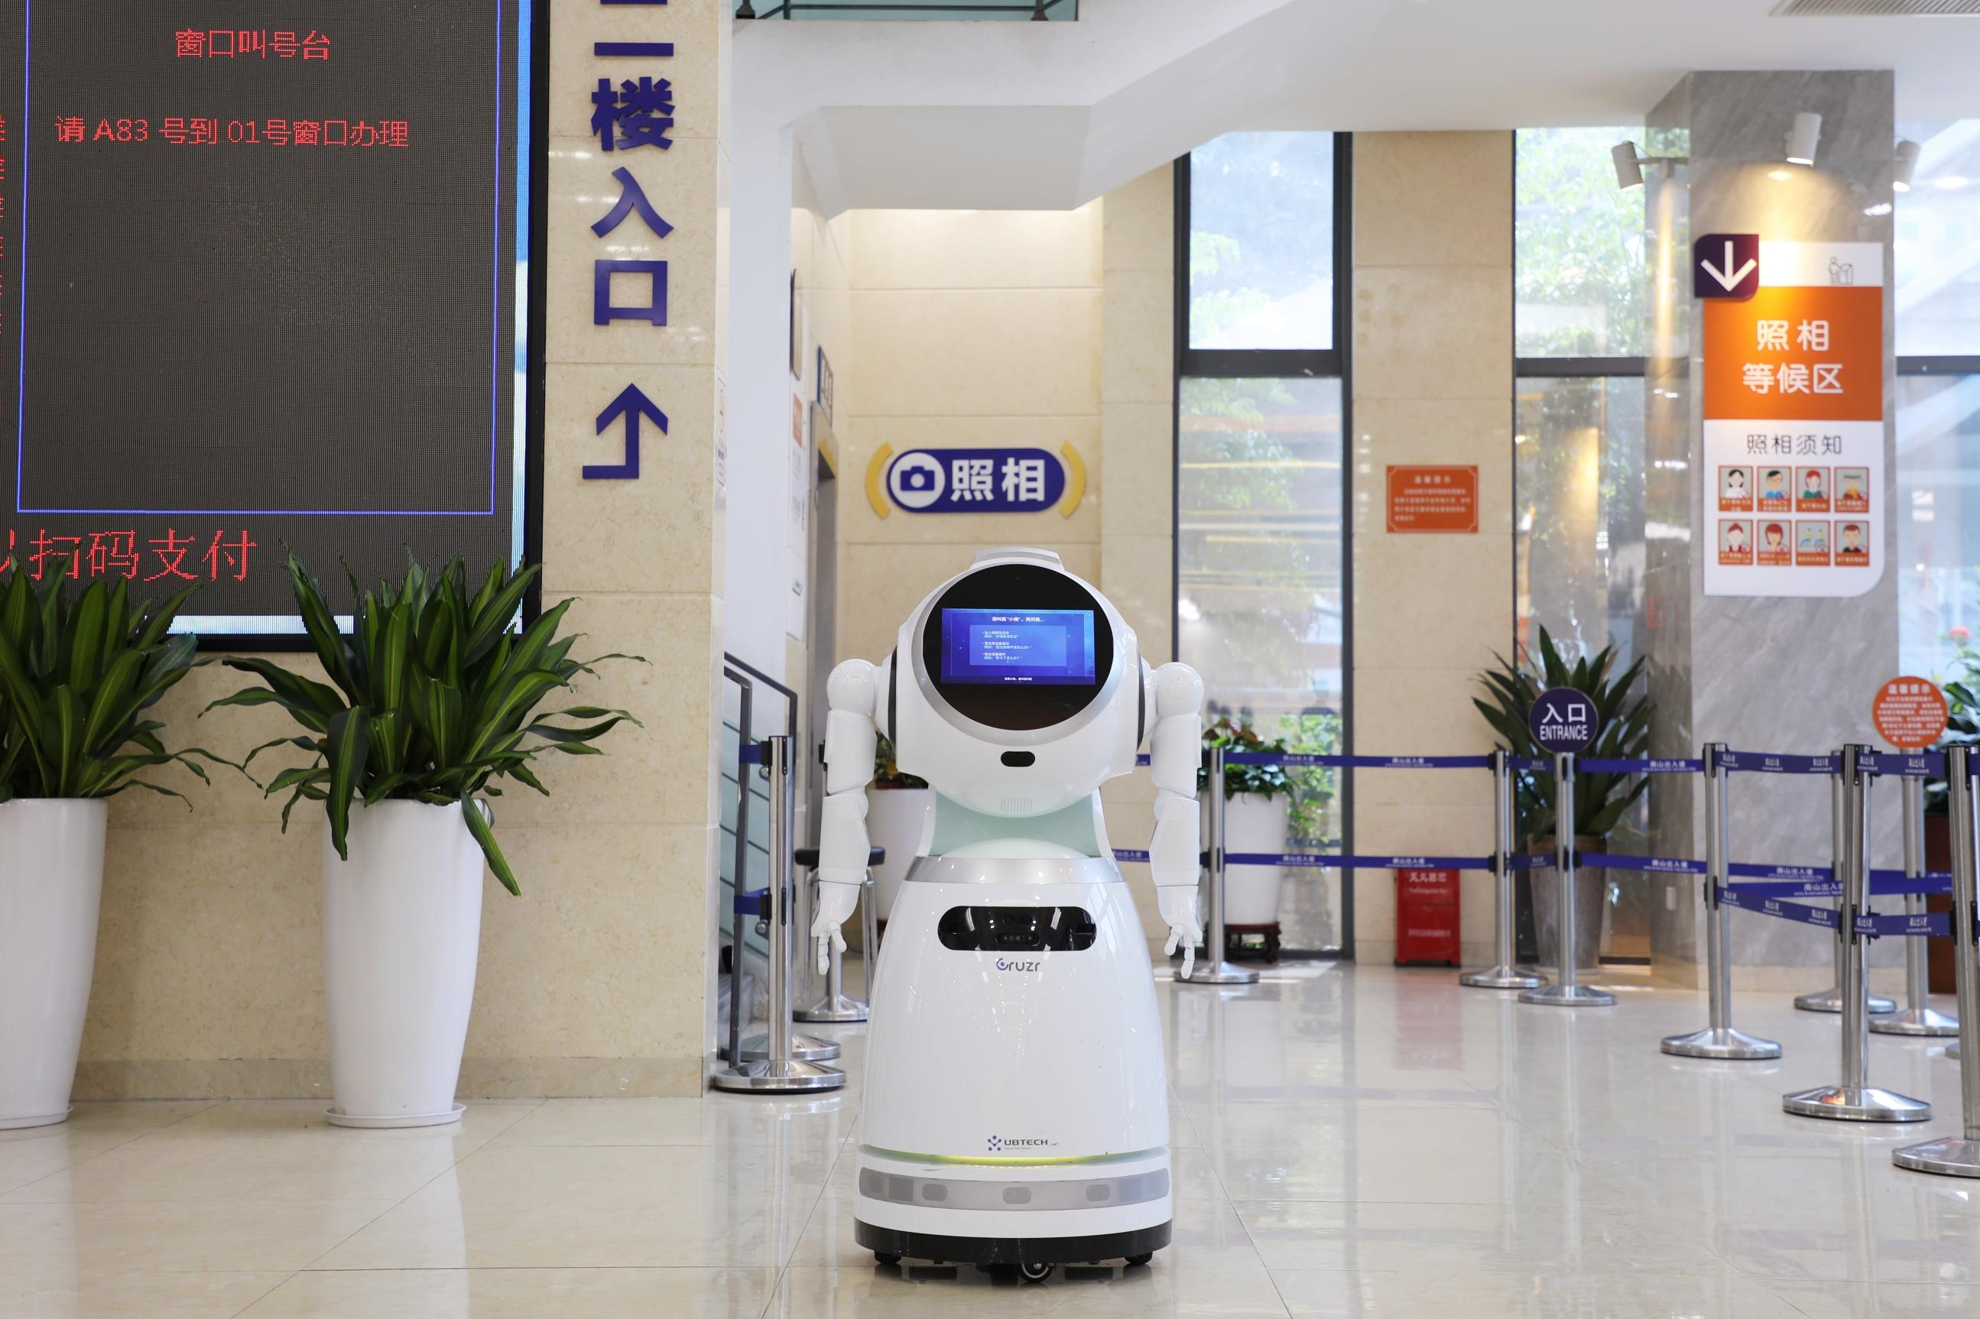
AI+ Public Security
Application Cases
Provides Exit-entry consultation and shows distinctly different processes for citizens
Provided helpful enquiry service and professional Q&A related to Exit-entry, relieves the workload of police officers, and optimizes work deployments

Slide 37
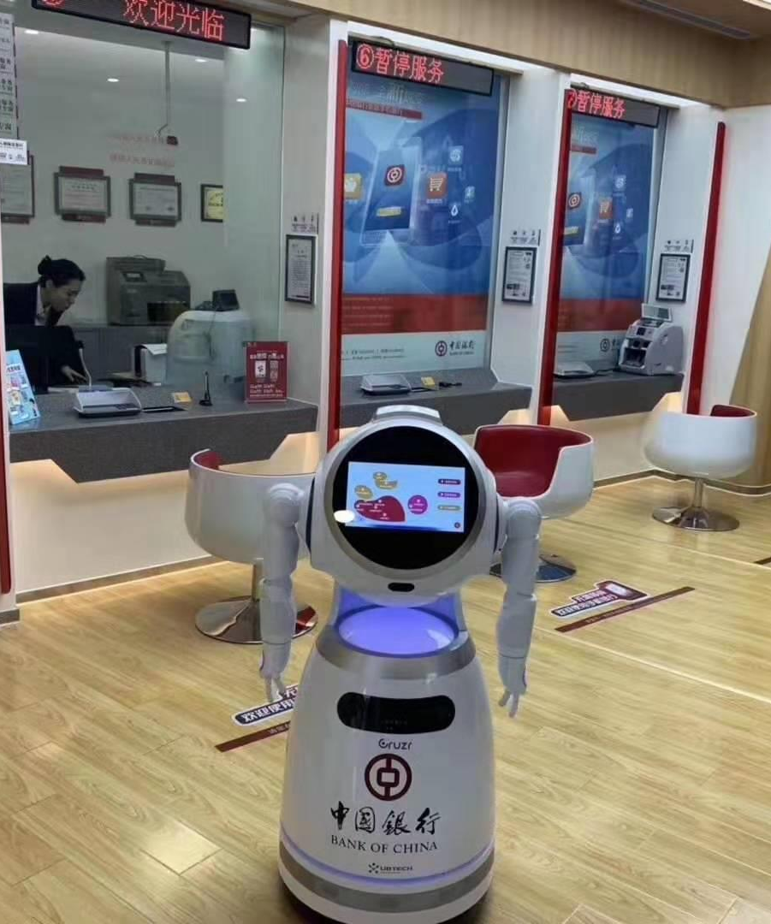


AI+ Bank Application Cases
Cruzr robot can precisely guide customers to business areas through the U-SLAM Stereo Navigation Obstacle Avoidance System
Answers customers’ questions in business transaction, and assists bank make business promotion, if the robot can handle some issue, which the video customer service will solve
Patrolling broadcasting attentions and promotions of bank, and real-time monitoring bank and send the real-time circumstance to administrators
Bank lobby assistance, help lobby manager to handle business transactions, like scanning QR code for a new card, make an appointment withdrawal, etc.

Slide 38

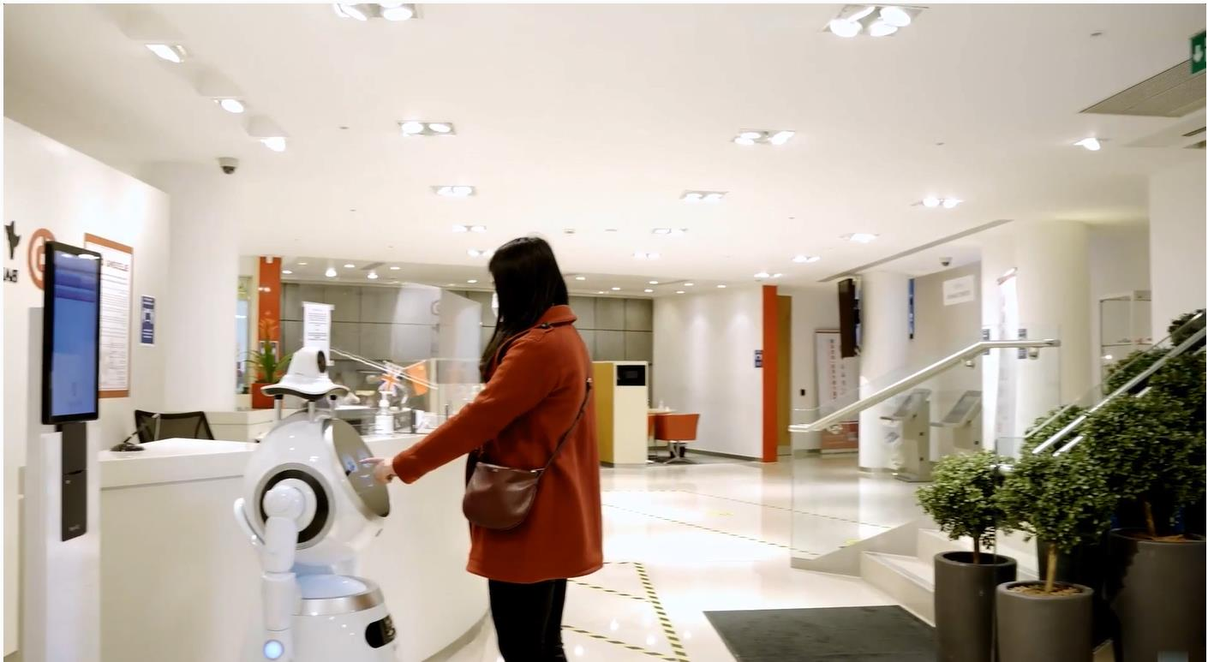
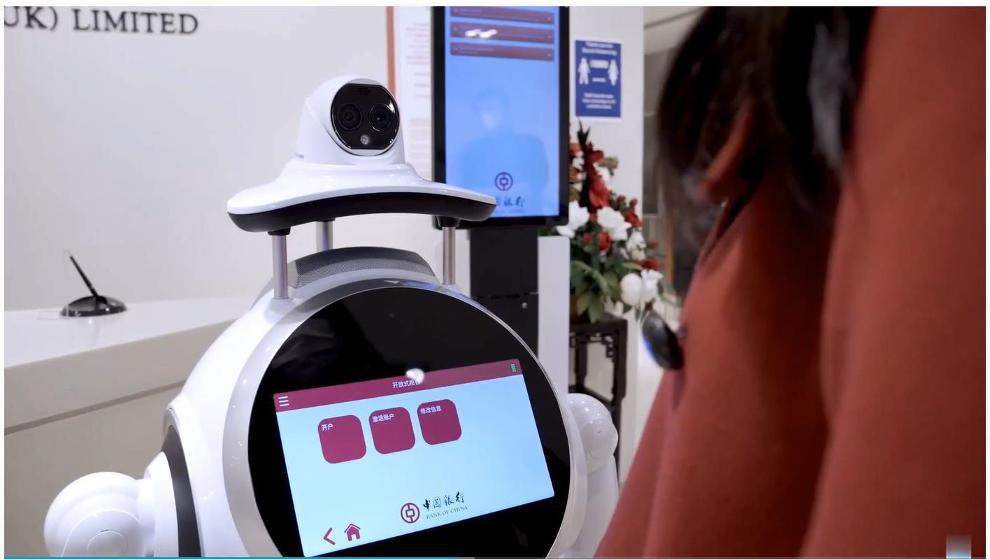
AI+ Bank Application Cases
Bank of China (UK) Limited London Chinatown Branch
Bank of China (UK) Limited Banking Department
Cruzr conducts thermometry, mask detection, and mask reminder at the entrance
Cruzr has connected to the queuing system of the bank to realize the ability to guide custom into different types of business and to queue

Slide 39
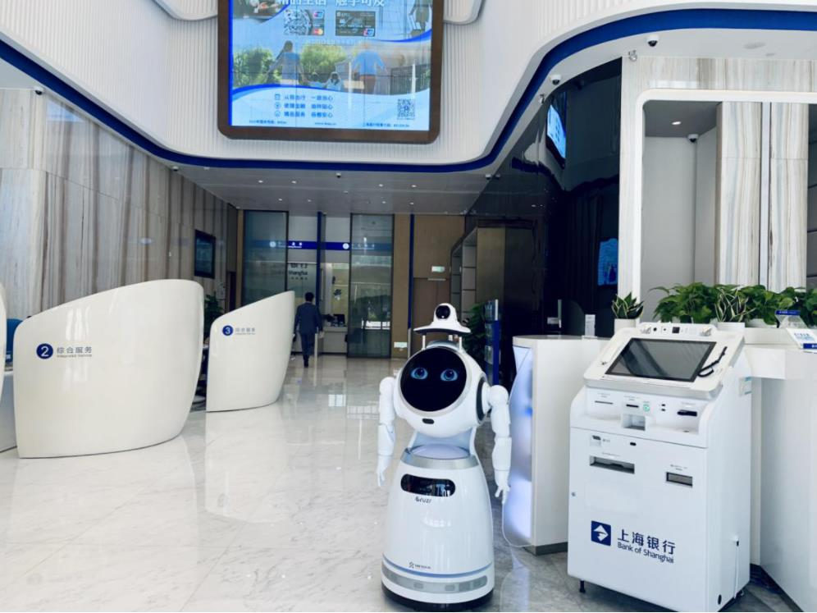

AI+ Bank Application Cases
Cruzr launched 6 service outlet of the bank of Shanghai Shenzhen Branch
Cruzr conducts thermometry, mask detection, and mask reminder at the entrance
Cruzr answers customers’ questions, such as business transactions, and assists banks in making business promotions
Bank lobby assistance, help lobby manager to handle business transactions, like scanning QR code for a new card, make an appointment withdrawal, etc.
Bank of Shanghai

Slide 40




THANK YOU!
MOBILE-ID TECHNOLOGIES & SERVICES JOINT STOCK COMPANY
19 Dang Tien Dong street, An Phu ward, Thu Duc City, Ho Chi Minh City
028 3636 6015
info@mobile-id.vn

